Slide 1
PM 101
DAY 2

Slide 2
MODULE EIGHT
Schedule

Slide 3
“Triple Constraint” Key Parameters – Schedule
How long will it take?
Product Performance
Specified Attributes
Cost
Schedule
Budget
Time
Parkinson’s Law: “Work expands so as to fill the time available for its completion.”
Notes:
Parkinson's Law is the adage first articulated by Cyril Northcote Parkinson as the first sentence of a humorous essay published in The Economist in 1955:

Slide 4
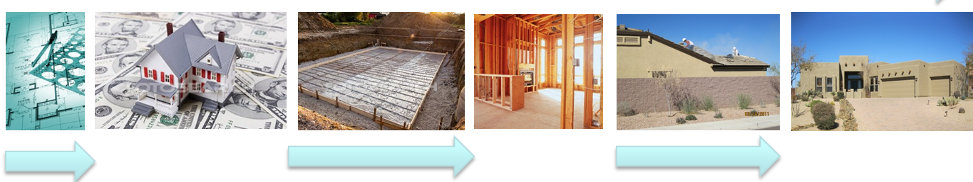
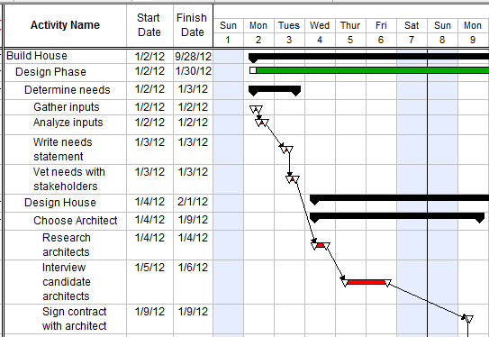
Schedule Example
Design
1 Jan
31 Jan
1 Mar
1 May
1 Jul
1 Sep
30 Sep

Slide 5
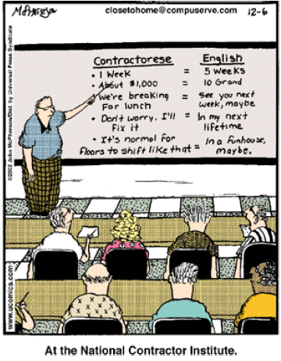
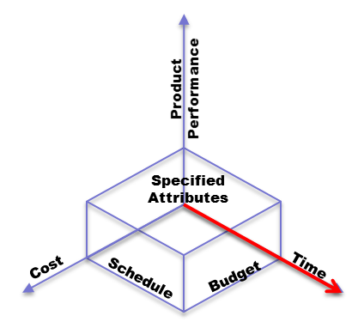
Schedule Accuracy
Consensus-driven estimation method - WAG
Close to Home
by John McPherson
WAG: Wild Accounts* Guess
Notes:
WAG – Wild Accountant’s Guess

Slide 6
Schedule Definition
List of a project's terminal elements
lowest element which is not further subdivided
with intended start and finish dates
where each date in the schedule is estimated
A schedule itself is an estimate

Slide 7
Schedule Accuracy
Development and maintenance of the schedule
A full time scheduler or team of schedulers
May be organized under the department of project control
Things to remember:
If there is more than one schedule, you have no schedule
All inputs are not equal, true accuracy depends on a single data source
Baseline is a baseline! Changes are reflected on the baseline not to it!
A resource loaded schedule is the ultimate, but not always possible
Depends upon authoritative input from all functional areas to be accurate
Notes:
Management techniques:
Define project activities
Estimate the activity duration using references, professional contacts, actual task completion personnel
Track progress using PM tools: Gantt Chart, Work Breakdown Structure, Network Diagram…….
(WB pgs. )

Slide 8
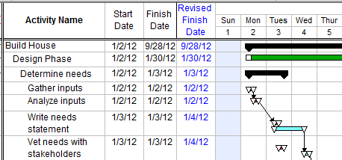
Schedule Accuracy
Schedule must be constantly updated
Not static – stuff happens
Initial estimates are wrong
People get sick or change jobs
External resources change
Things don’t work as anticipated
A scheduler’s job is never complete!
Notes:
Management techniques:
Define project activities
Estimate the activity duration using references, professional contacts, actual task completion personnel
Track progress using PM tools: Gantt Chart, Work Breakdown Structure, Network Diagram…….
Integrated Master Plan (IMP) and Integrated Master Schedule (IMS)
The IMP is an event driven plan:
Documenting the significant accomplishments necessary to complete the work
Linking each accomplishment to a key program event
The IMS is :
An integrated and networked multi-layered schedule of program tasks required to complete the work effort captured in a related IMP, and should:
include all IMP events and accomplishments
Support each accomplishment closure criteria
A time-based schedule containing the networked, detailed tasks necessary to ensure successful program/contract execution.
Traceable to the integrated master plan, the contract work breakdown structure, and the statement of work
Used to verify attainability of contract objectives, to evaluate progress toward meeting program objectives, and to integrate the program schedule activities with all related components.
The IMP and IMS are business tools that:
Provide for improved day-to-day program execution
Afford on-going insight into program status by both the government program office personnel and contractor personnel
Help to support the “what-if” exercises
Identify and assess candidate problem workarounds
Focus and strengthen the Government-Contractor team
Enhance the management of acquisition, modification and sustainment programs
Provide a systematic approach to program planning, scheduling and execution
Are equally applicable to competitive and sole source procurements with industry, as well as government in-house efforts
A well-prepared IMP and IMS are tools with a wide range of value added management applications:
In preparing for source selection and its activities, the IMP and IMS:
Give offerors flexibilitiy in performing detailed program execution planning, organization and scheduling within any existing Request for Proposal (RFP) constraints
Serve as the basis for the offeror’s detailed execution IMS of how the contractor intends to meet the RFP requirements
Encourage the use of real integrated product development and systems integration approaches
All necessary functional disciplines should be contributing at this time and the offeror’s IMS should contain the integrated network formed by all the necessary tasks and their inter-relationships
Provide the Government proposal evaluation team with the information needed to assess each offeror’s requirements including Mission Capability, Proposal Risk, Performance Confidence and Price and Cost evaluation factors
After the contract award, the government and contractor’s plans and schedule:
Provide the detailed integrated execution plan and supporting schedule, clearly identifying what has to be done and when it must be done
Serve as the basis for ensuring mutual understanding of government expectaations and agreement on the program content, program plan, schedule and risk
During the actual program execution, the IMP and IMS:
Provide a framework for insight into the contractor’s performance for both the program office and for the contractor’s management team
When properly integrated with EVM through a sound technical management approach as documented in the program’s Systems Engineering Plan (SEP), enable the program management office to:
Identify and assess actual progress versus the planned progress
Monitor the program critical path and help develop workarounds to problem areas
Appraise program maturity
Evaluate the status of risk management activities based on the inclusion of the program risk mitigation activities in the IMP and IMS
Assess the progress on selected Key Performance Parameters (KPPs) and Technical Performance Measures (TPMs)
Provide an objective, quantitative basis for the contractor’s performance assessment rating award fee
Afford better insight into potential follow-on efforts that were not part of the original contract award
(WB pgs. )

Slide 9
Integrated Master Plan (IMP)
The IMP is an EVENT driven plan that encompasses the entire program
Broken down in three levels
Events (top level view of the project/program)
Accomplishments (all those needed to finish an event)
Includes required progress of all functional disciplines
When completed should substantially contribute to success of Event
Criteria (How do I know when an Accomplishment is completed—what are the parts?)
Includes a Narrative to describe how things where determined to fit together, along with assumptions and scope of the effort involved
Normally is the plan that is put on contract
Caution; since this is on contract it should be at a level where there is flexibility below the criteria so changes are minimized

Slide 10
Integrated Master Schedule (IMS)
Building the IMS:
Break down IMP criteria
as many levels as needed to get to a “unique severable piece of work” - TASKS
Determine all TASK durations independently
Link TASKS logically together
Predecessor(s)
Follower(s)
Given required predecessors TASKS
determine earliest start time.
If a follower TASKS
is waiting for another predecessor
then there will be slack time.
All TASKS along the path with no slack time defines the “critical Path.”

Slide 11
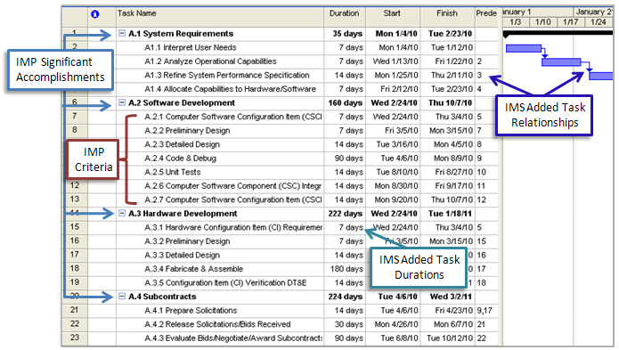
Building the Schedule

Slide 12
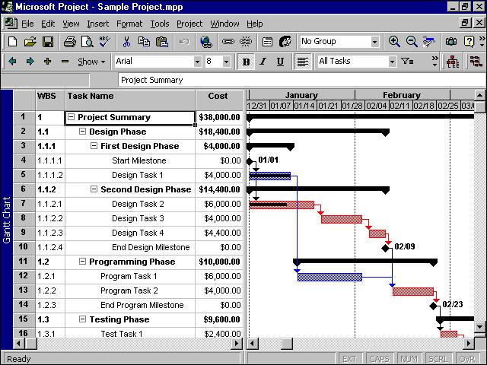
Critical Path

Slide 13
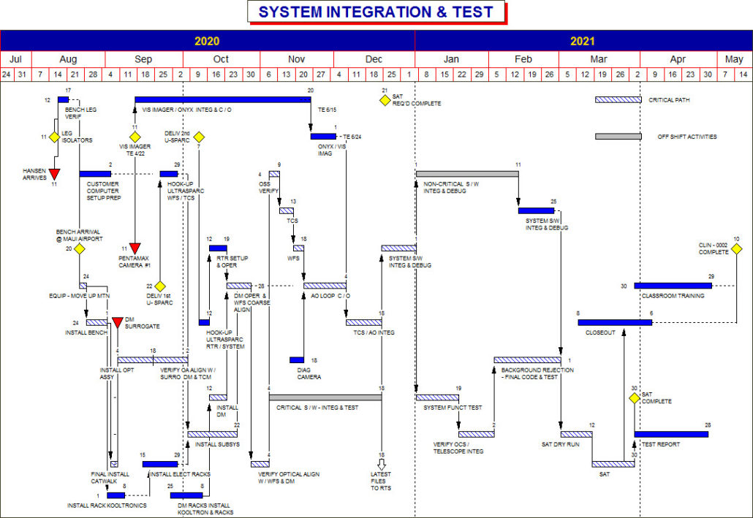

Slide 14

Schedule

Slide 15
Exercise # 6/#7
Integrated Master Plan/Integrated Master Schedule
WB pgs. 19 - 27

Slide 16
IMP/IMS Exercise
Use the IMP Template
Develop a list of tasks
Event
Accomplishment
Criteria
Use the IMP and build the Schedule (IMS)
Break down IMP Criteria to the TASK level
Start and finish dates (duration)
String them together in a logical relationship
Predecessors
Dependencies and/or independent items
Resource loading?
Critical Path
IMP: Integrated Master Plan IMS: Integrated Master Schedule

Slide 17
MODULE NINE
Performance

Slide 18

“Triple Constraint” Key Parameters – Performance
Product Performance
Specified Attributes
Cost
Schedule
Budget
Time
Is it capabilities based?
Does it tell how well or how to? Does it describe a system or a systems attributes?
Reflects the major purpose of the project
- That is to develop or produce a solution to satisfy a customer’s (warfighter’s) need (ICD, CDD, CPD)
ICD: Initial Capabilities Document CDD: Capabilities Development Document CPD: Capabilities Production Document
Notes:
Major thing to consider when reviewing/reading a Needs Document. Is it capabilities based? Does it tell how well or how to? Does it describe a system or a systems attributes?

Slide 19
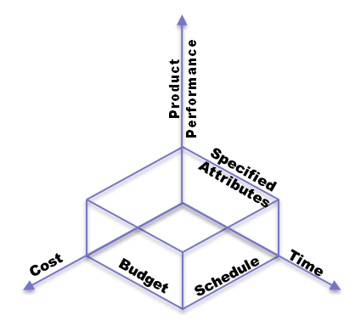
Performance
Performance is made up of the technical parameters that define the system capabilities
How big (weight or volume or Megabytes)
How fast (MPH or Mbps)
How long it lasts (10 years or 10 minutes)
Included as TPM* in a Specification
Performance, Requirements, or Scope
What is the Scope?
Defined in the Statement of Work (SOW) or Performance Work Statement (PWS)
It defines all the work to be done.
Converted into a Work Breakdown Structure (WBS)
Out of scope – what has not been specified
In scope – what has been specified
(KPPs)
How much performance you can afford in the time allotted
* Technical Performance Measure (TPM) MPH: Miles Per Hour MB/S: Megabits per Second
Notes:
The balance in Performance is a combination of the technical needs (TPMs) and the scope (KPP, WBS, SOW) of the capabilities.

Slide 20
Scope Management Tools & Techniques
Scope Planning – Create a scope management plan documenting
how scope will be defined, validated, controlled
how the WBS will be created and defined (tailored Mil-Std-881C)
Project Overview Statement
WBS – Subdivide the major project deliverables and project work into smaller, more manageable components
SOW/PWS – What are the tasks that must be done to produce the project deliverables
Verification – Formalizing acceptance of the completed project deliverables
Control – Controlling changes to the project scope
WBS: Work Breakdown Structure MIL-STD: Military Standard SOW: Statement of Work
PWS: Performance Work Statement
Notes:
An interesting aspect to consider is the interplay of Performance, with cost and Schedule. You’ll see this in the WBS, SRD, SOW and how they are connected to the IMP/IMS and the POE & EVM data.

Slide 21
Scope Management Tools & Techniques
Project Overview Statement
Clearly define/articulate the purpose of a project,
the challenges, constraints and assumptions
Opportunity – why the project is being undertaken
Goal – clearly defined product or service
Objectives – that drive project towards the goal (steps)
Success Criteria – specific and measurable
Assumptions – that were made and why
Risks – most probable (Likelihood and Consequence)
Obstacles – and how to avoid or mitigate
Known Unknowns
Unknown Unknowns
Notes:
Statement of Work (SOW) – The program’s SOW :
Critical communication document between the program manager and the customer
Narrative description of products or services to be delivered by the program
Once written, becomes a document subject to negotiation and modification by the stakeholders
When approved, becomes the Official Rules for the program
MIL-HDBK-245D – provides format for the SOW:
Deviations form the standard format may be made by the writer when necessary to accommodate prevailing program needs
The scope paragraph defines the breadth and limitations of the work to be done
In some cases, the use of an introduction, background, or both, is preferred, however background information should be limited to only that information needed to acquaint the proposer with the basic acquisition requirement.

Slide 22

Performance Define Requirements
Clearly identify the project’s: Opportunity
Goal
A place to live
Objectives
Comfortable
Energy efficient
Quiet
Main drivers
Size
Cost
Affordability
Schedule
(assumptions, risks & Obstacles)
In scope – what has been specified
Success Criteria
On Cost
On Schedule
Performance meet or exceeds requirements

Slide 23

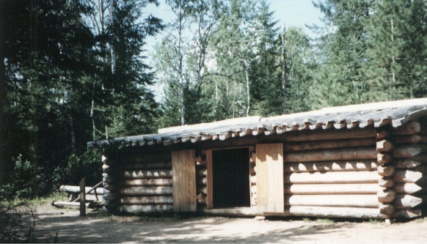
Performance Requirements Analysis
Needs analysis
Out of scope – what has not been specified
Exceeds needs with capabilities not specified as needed
In scope – what has been specified
Meets Needs ?
Needs analysis
Yes
No
Does not meet needs

Slide 24










Stakeholder’s View of the Requirements
How the Service described it. | How the requirement was understood | How the contractor designed it | How the programmer wrote it | How the PEO described it
How the project was documented | What SYSCOM installed | How the Government was billed | How the helpdesk supported it | What the user really needed
PEO: Program Executive Officer SYSCOM: Systems Command

Slide 25


Performance Trade Studies
Define what’s in and what’s out
Out of scope – what has not been specified
In scope – what has been specified
THRESHOLDS (minimum acceptable)
OBJECTIVES (desired but not required)
Schedule
le
Performance
Cost

Slide 26
Functional Analysis
What are the Functions of the System
Satellite Example
Locate (where are you, where are you looking?)
Sense (collect data)
Transmit (send data)
Distribute (where, when, how)
Control (location, data, distribution)
Home Example
Shelter (environment, size, type)
Location (City/State, urban/rural, exposure, work/school)
Transportation (POC, Public, distance)
Education (school, district, rating)
Entertainment (sports, cultural, leisure)
Support (Operations, maintenance, modification)
How far do you break down the FUNCTIONS before you get to a design, system, subsystem or product?
POC: Privately Owned Conveyance

Slide 27
Systems Engineering Process
Process Input
System Analysis and Control (Balance)
Requirements Analysis
Requirements Loop
Functional Analysis and Allocation
Design Loop
Verification
Design Synthesis
Process Output
Notes:
The systems engineering process is a top-down comprehensive, iterative and recursive problem solving process, applied sequentially through all stages of development, that is used to:
Transform needs and requirements into a set of system product and process descriptions (adding value and more detail with each level of development),
Generate information for decision makers, and
Provide input for the next level of development
Fundamental systems engineering activities are
Requirements Analysis,
Functional Analysis and Allocation, and
Design Synthesis
Balanced by techniques and tools collectively called System Analysis and Control.
Systems engineering controls are used to
Track decisions and requirements,
maintain technical baselines,
manage interfaces,
manage risks,
Track cost and schedule,
track technical performance,
verify requirements are met, and
review/audit the progress.
Source: : SYSTEMS ENGINEERING
FUNDAMENTALS; SUPPLEMENTARY TEXT PREPARED BY THE DEFENSE ACQUISITION UNIVERSITY PRESS
FORT BELVOIR, VIRGINIA 22060-5565; Jan 2001; page 5-6

Slide 28
Satellite “Survivability Function”
SURVIVE
MANEUVER
DETECT
BLOCK
CHANGE
PITCH
CHANGE
YAW
OPTICAL
ACTIVATE
SENSE
ACTIVATE
CHANGE
ROLL
Functional Architecture

Slide 29
Satellite “Survivability Systems”
Weather Satellite DEFENSE
SYSTEM
ATTITUE
CONTROL
MECHANISM
LASER
SENSOR
OPTICAL COATING
SHUTTER
HARDWARE
SOFTWARE
INPUT
OUTPUT
Physical Architecture

Slide 30
Requirements Development
Needs Analysis
Face-to-face with Requirements document authors (A5)
Understand the constraints (solutions) & CONOPS
What and how well does the system need to perform (SRR)
Priorities and concerns
Suggest Concepts
Functional Analysis (SFR to PDR)
What are the full set of functions, break down in hierarchy
Develop products to accomplish functions (first level trades)
Organize products under functions and Identify Interfaces
Design Analysis (PDR to CDR)
Define products and characteristics
Develop options and assign functions and characteristics
Assess completion of products and their characteristics (traceability)
Home Example
Shelter (environment, size, type)
Location (City/State, urban/rural, exposure, work/school)
Transportation (POC, Public, distance)
Education (school, district, rating)
Entertainment (sports, cultural, leisure)
Support (Operations, maintenance, modification)
SRR: Systems Requirements Review
SFR: Systems Functional Review
PDR: Preliminary Design Review
CDR: Critical Design Review

Slide 31
Performance Define, Refine and Set Requirements
Define what’s in and what’s out
Setting the “technical baseline”
FUNCTIONAL
ALLOCATED
PRODUCT
Out of scope – what has not been specified
In scope – what has been specified
14’ ceilings
Solarium
Integrated Priority list
3 bedrooms
2 ½ Baths
Family room
Eat-in kitchen
2 x 6 construction
2 car garage
Tile flooring in baths, kitchen, halls
Carpet in bedrooms
Granite counter tops in kitchen
Carpet in bedrooms, family room
Pool
SMART House
3 bedrooms
2 car garage
2 ½ Baths
Expanded garage
Tile flooring in baths, hallways, kitchen
Eat-in kitchen
Marble floors
Gourmet appliances
Expanded garage
14’ ceilings
Marble flooring
Pool
Solarium
SMART House
Family room
Granite counter tops in kitchen
2 x 6 construction
Gourmet appliances

Slide 32
Performance Management Tools & Techniques
Validation – Formalizing approval of the Requirements by the stakeholders
OK!
Carpet in bedrooms in family room
Integrated Priority list
3 bedrooms
2 ½ Baths
Family room
Eat-in kitchen
2 x 6 construction
2 car garage
Tile flooring in baths, kitchen, halls
Carpet in bedrooms
Granite counter tops in kitchen
__________________________
Gourmet appliances
Expanded garage
14’ ceilings
Marble flooring
Pool
Solarium
3 bedrooms
2 car garage
IN
2 ½ Baths
Tile flooring in baths, hallways, kitchen
Eat-in kitchen
Family room
2 x 6 construction
Granite counter tops in kitchen
OUT
Notes:
(A) stakeholder(s)
- is someone who has a vested interest in the success of a project/program
- are individuals and organizations who are actively involved in the program or whose interests may be positively or negatively affected as a result of program execution or successful program completion.
- are people and organizations that ultimately judge the success of the program are
Program Manager
Program Team
Management
Program Sponsor
Resource Manager
Decision Authority
Customer
Representatives of External Constraints
Advocates, Opponents and Innocent Bystanders
It is advisable for the program manager to identify all of the program stakeholders because all the important decisions need to include them.
SMC strengthens its partnerships and relationships with key members of the broader space community. To ensure an adequate technology base for space and missile programs SMC actively pursues comprehensive interaction with industry to develop standards, “best practices”, information sharing, and “benchmarking” with individual companies.
To ensure synergy across the full spectrum of the space enterprise, SMC participates in space community forums with partners including;
National Reconnaissance Office (NRO),
National Aeronautics and Space Administration (NASA),
National Oceanic and Atmospheric Administration (NOAA),
National Security Agency (NSA),
and commercial companies

Slide 33

Management Tools & Techniques
Control – Controlling changes to the project
Configuration Control Board
Requirements Management Plan
Manage requirements creep
Be realistic and proactive

Slide 34
Requirements Management Tools & Techniques
Managing Requirements change/creep
Integrated Priority list
3 bedrooms
2 ½ Baths
Family room
Eat-in kitchen
2 x 6 construction
2 car garage
Tile flooring n baths, kitchen, halls
Carpet in bedrooms
Granite counter tops in kitchen
__________________________
Gourmet appliances
Expanded garage
14’ ceilings
Marble flooring
Pool
Solarium
IN
OUT
Keep records of the decisions made
What is in and out of scope and why
(a Decision Database)

Slide 35
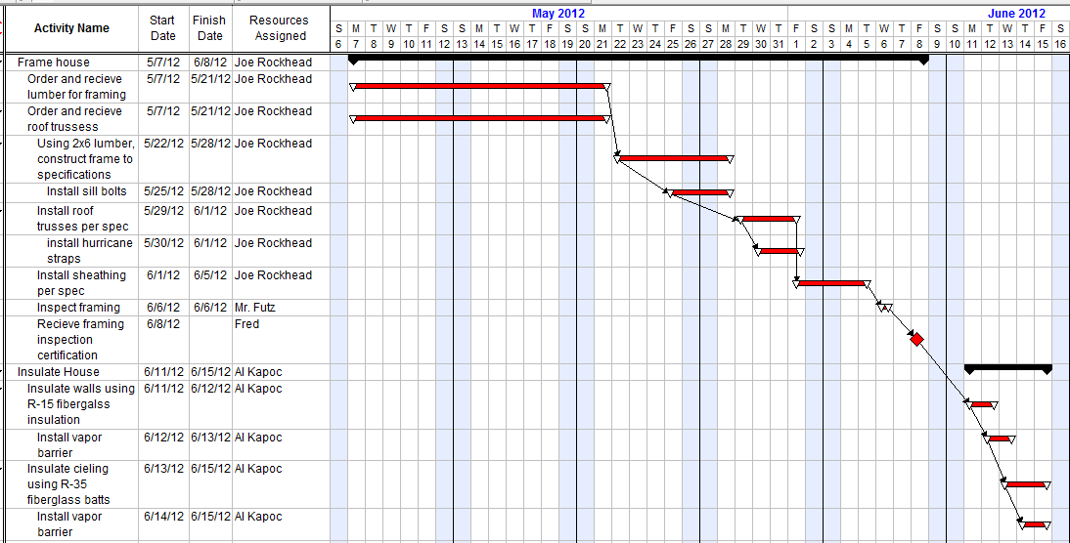
Requirements Management Tools & Techniques - Specifications
Other tools? WBS, SOW, IMS – Caution: one location to control consistency!
Specifically states “R-15”, so if one now wants “R-30” it is requirements creep
Any out of scope task is apparent if tasks are adequately defined
Notes:
The WBS organizes and defines the total scope of the project, and represents the work specified in the current approved program scope statement
The planned work is contained within the lowest level WBS components, called work packages
A work package can be scheduled, cost estimated, monitored and controlled
In the context of the WBS, work refers to work products or deliverables that are the result of effort and not to the effort itself.
Note: Good reference information for the WBS can be found at:
http://workbreakdownstructure.com/

Slide 36
Requirements Management Tools & Techniques
Managing Requirements creep
Carpet in bedrooms, family room
3 bedrooms
OK!
2 car garage
2 ½ Baths
Tile flooring in baths, hallways, kitchen
Eat-in kitchen
Family room
Granite counter tops in kitchen
2 x 6 construction
This is why you validated the requirements with the stakeholders – now all you have to do is manage the stakeholders expectations

Slide 37


Requirements Management Tools & Techniques
Managing requirements creep
OK!
OK!
$100 per ft²
$60 per ft²
Granite counter tops in kitchen
Managing stakeholders expectations is extremely important to project success
Notes:
Requirements! Requirements! Requirements!

Slide 38
Requirements CREEP

Slide 39
Exercise #8
Requirements Definition
Initial Capabilities Document
&
Systems Requirements Document
WB pgs. 28 - 34

Slide 40
Requirements Definition Exercise #8
Building the Systems Requirements Document (SRD)
Source document (ICD, CDD, CPD)
Requirements Analysis (definition, needs, etc.)
Requirements Synthesis (concepts, systems, products)
Trade Studies (analysis)
A Specification is the technical document that describes the systems parameters, how they will be verified, if there are packaging requirements and then any NOTES!
A specification has these sections per Mil-Std-961!
1. SCOPE
2. APPLICABLE DOCUMENTS
3. REQUIREMENTS
4. VERIFICATION
5. PACKAGING
6. NOTES
SRD: Systems Requirements Document ICD: Initial Capabilities Document CDD: Capabilities Development Document
CPD: Capabilities Production Document

Slide 41
MODULE TEN
Systems Engineering

Slide 42
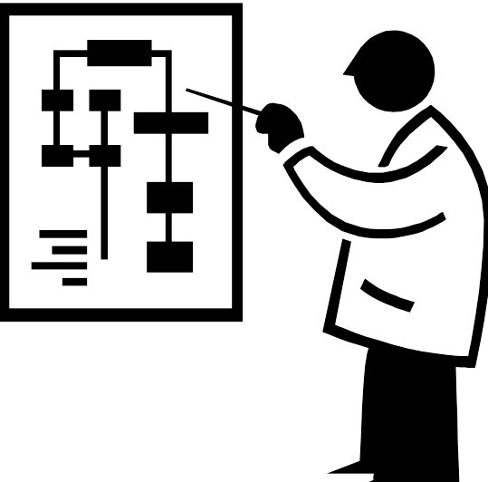
Learning Objectives
Provide a program manager’s perspective on SMC engineering activities and responsibilities that include:
A top-level description of systems engineering (SE)
System engineering language and process perspectives
Discussion of the general SE concepts and associated processes, tools, and techniques
An SE function overview during the acquisition lifecycle
Show SE’s universal applicability across technologies and diverse development programs

Slide 43
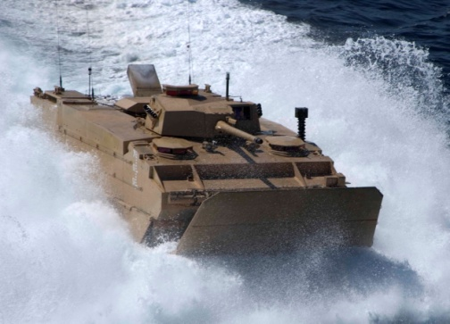
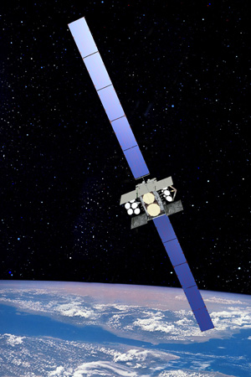
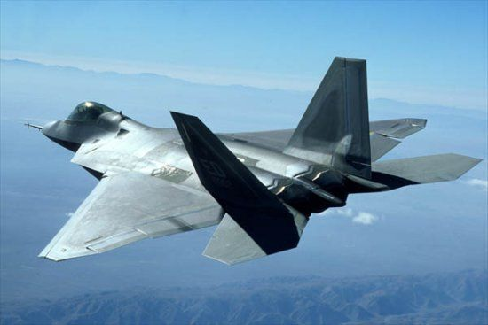
Why Emphasis on SE
… quality problems with the Expeditionary Fighting Vehicle program were so significant that DOD extended development 4 years at a cost of $750 million
… F-22A fighter aircraft experienced cracks in the plane’s canopy that grounded the flight test aircraft
… initial operating capability for the Wideband Global SATCOM (WGS) satellite was delayed 18 months because a supplier installed some fasteners incorrectly
GAO’s analysis of 11 DOD weapon systems illustrates that defense contractors’ poor practices for systems engineering activities … contributed to these outcomes.
DOD: Department of Defense SATCOM: Satellite Communications GAO: Government Accountability Office
Notes:
Source: Highlights of GAO-08-294 - Increased Focus on Requirements and Oversight Needed to Improve DODs Acquisition Environment and Weapon System Quality

Slide 44
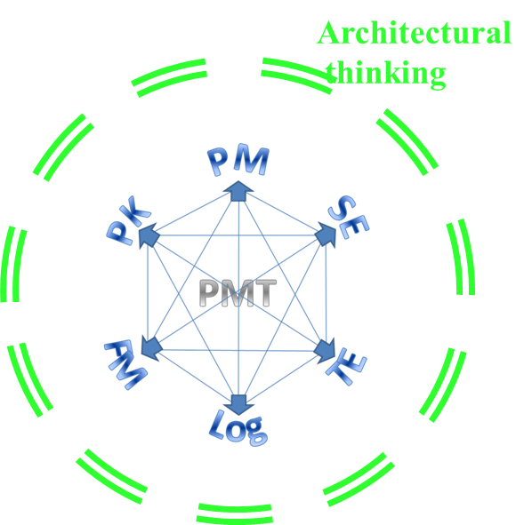
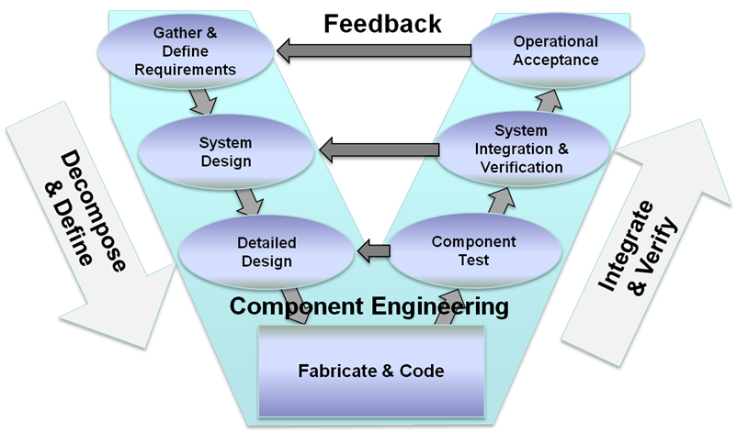
Basic Concepts
Orientation
SMC Approach Systems Engineering
User Needs
Technology Opportunities & Resources
A
B
C
Material Solution Analysis
Material Development Decision
Technology Maturation & Risk Reduction
Engineering and Manufacturing Development
Production and Deployment
Operations and Support
Post- PDR A
Post- CDR A
FRP –Decision Review
PDR: Preliminary Design Review CDR: Critical Design Review FRP: Full Rate Production PMT: Program Management Team

Slide 45
Space Business is Challenging
An Unforgiving Business;
One Strike and You’re Out
Virtually no way exists to retrieve or modify a launched spacecraft to repair or replace it
High expectations with each mission
(100% Mission Success)
Space systems expected to work for long periods of time; typically ten years or longer, and in a harsh environment
Any major failure on newly deployed systems could lead to coverage gaps
Bottom line: Mission Success is job #1....and, there is simply no substitute for good systems engineering

Slide 46
Mission Assurance (Many Technical Disciplines to Manage)
Systems Engineering
Program & Supplier Management
Design Reviews
Industrial Base
Manufacturing
Software
Parts, Materials, & Processes
BOX
Test
Quality Assurance
Reliability
Survivability
Structures
EMI/EMC
Power
Space Systems are Complex and then!!!

Slide 47
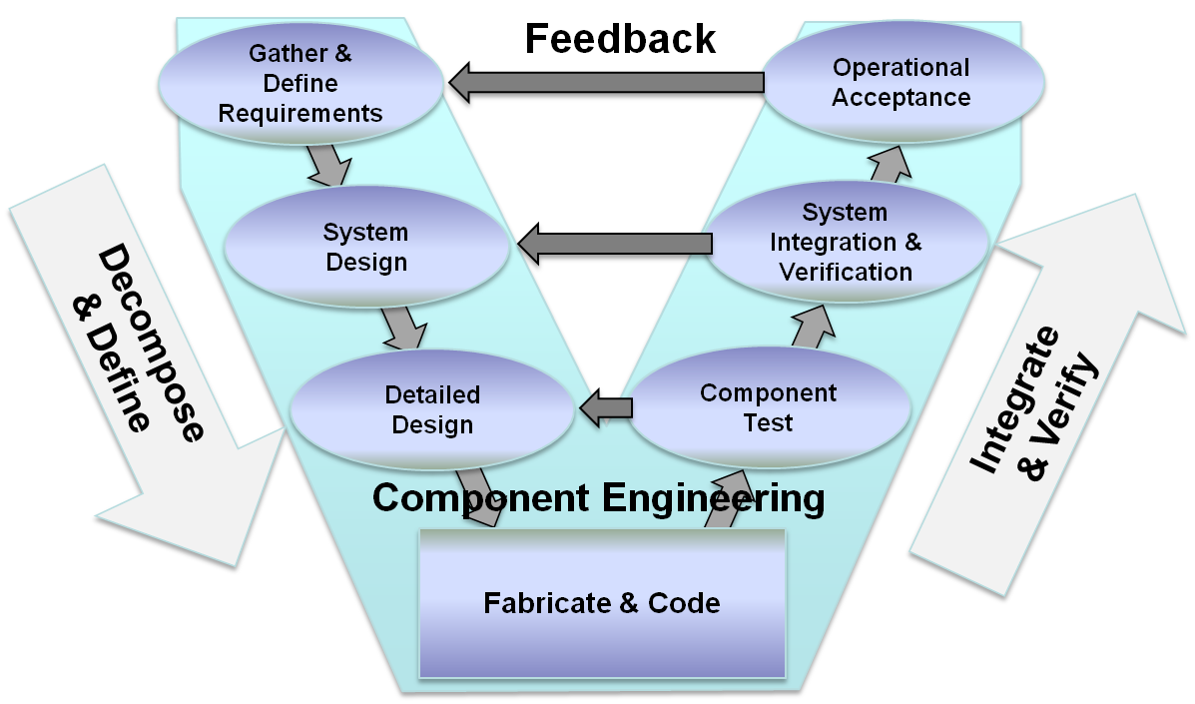
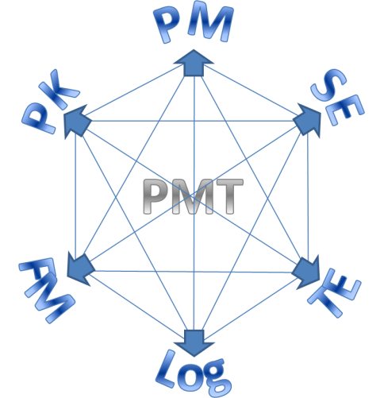
SE Definition
Systems engineering is a comprehensive, structured approach using “best practices” for the design, creation, and operation of a system in a cost-effective manner using an interdisciplinary approach
Architectural
thinking
SE: Systems Engineering PMT: Program Management Team
Notes:
Webster defines a system as "A group of devices or artificial objects or an organization forming a network, especially for distributing something or serving a common purpose," or "A regularly interacting or interdependent group of items forming a unified whole."
Systems engineering is concerned with the overall process of defining, developing, operating, maintaining, and ultimately replacing quality systems. Whereas other engineering disciplines concentrate on the details of individual aspects of a system (electronics, mechanics, ergonometrics, aerodynamics, software, etc.), systems engineering is concerned with the integration of all of these aspects into a coherent and effective system. Systems engineers concentrate their efforts on the aspects of the engineering process (requirements definition, top-level functional designs, project management, lifecycle cost analysis, etc.) that serve to organize and coordinate other engineering activities.
Source: http://professionalpractice.asme.org/ProductMgmt/Systems/Introduction.cfm

Slide 48
SE Best Practices
Represent effective strategies, gained by experience in practice, for making programs successful when:
developing a system
making the right choice in acquiring system components
Captured in two principle ways:
Case Studies
Lessons Learned
Notes:
The concept of a ‘practice' is defined as:
A description of what constitutes the practice
A list of resources that support the application of the practice
A list of the available evidence regarding that practice
The ability for the acquisition workforce to comment on the existing knowledge about the practice and to share their experiences, which may corroborate or contradict what is already know
A description of what the practice is (e.g. what process should be followed);A list of resources that support the application of the practice (e.g. templates, forms, publications);A list of the available evidence regarding that practice (i.e. where it has been applied, what type of program it was applied on, and what the results were);The ability for the acquisition workforce to comment on the existing knowledge about the practice and to share their experiences, which may corroborate or contradict what is already know

Slide 49
SE Best Practices Case Studies
In-depth explorations of what happened on a particular program
Similar case and utilize lessons learned from it to avoid making the same mistakes
Case studies can be found:
AT&L, Office of Systems Engineering (IPPD case studies)
The Air Force Center for Systems Engineering (Case Studies)
Notes:
Source: DAG 4.6.2. Case Studies

Slide 50
SE Best Practices Lessons Learned
Tool used to help identify potential areas of risk associated with the system by reviewing the experiences encountered in past programs
Air Force Center for Knowledge Sharing Lessons Learned
Center for Systems Engineering at the Air Force Institute of Technology
Air Force Knowledge Management
Navy Lessons Learned System
Joint Center for Lessons Learned
Department of Energy Lessons Learned
NASA Lessons Learned Database
Notes:
Lessons learned databases document what worked and what did not work in past programs, in the hopes that future programs can avoid the same pitfalls. Lessons learned can be found at all levels of the program: managerial, system, sub-system, and component.
Lessons learned are most effective when analogous programs and systems are identified, and the lessons learned are applied with discretion and proper judgment, as opposed to non-applicable lessons being blindly followed.
Ideally, a program manager searches lessons learned databases for analogous systems, enabling the program manager to be better prepared to defuse potential problems before they become real problems or to see what solutions to similar problems worked well in the past. However, because lessons learned databases are currently highly decentralized, it is often difficult to efficiently and effectively find applicable lessons learned in a form that is useful.
Source: DAG 4.6.3. Lessons Learned

Slide 51
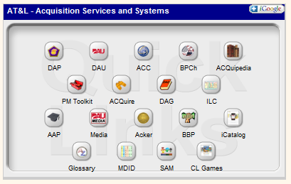

Where to Find Best Practices
Defense Acquisition University's Acquisition Knowledge Management System (AKMS)
Additional best practices links include:
The DoD Acquisition Best Practices Clearinghouse (BPCh)
The Government Accountability Office
The Systems Engineering Community of Practice
Notes:
A description of what the practice is (e.g. what process should be followed);A list of resources that support the application of the practice (e.g. templates, forms, publications);A list of the available evidence regarding that practice (i.e. where it has been applied, what type of program it was applied on, and what the results were);The ability for the acquisition workforce to comment on the existing knowledge about the practice and to share their experiences, which may corroborate or contradict what is already know
Source: DAG 4.6.1. Best Practices

Slide 52
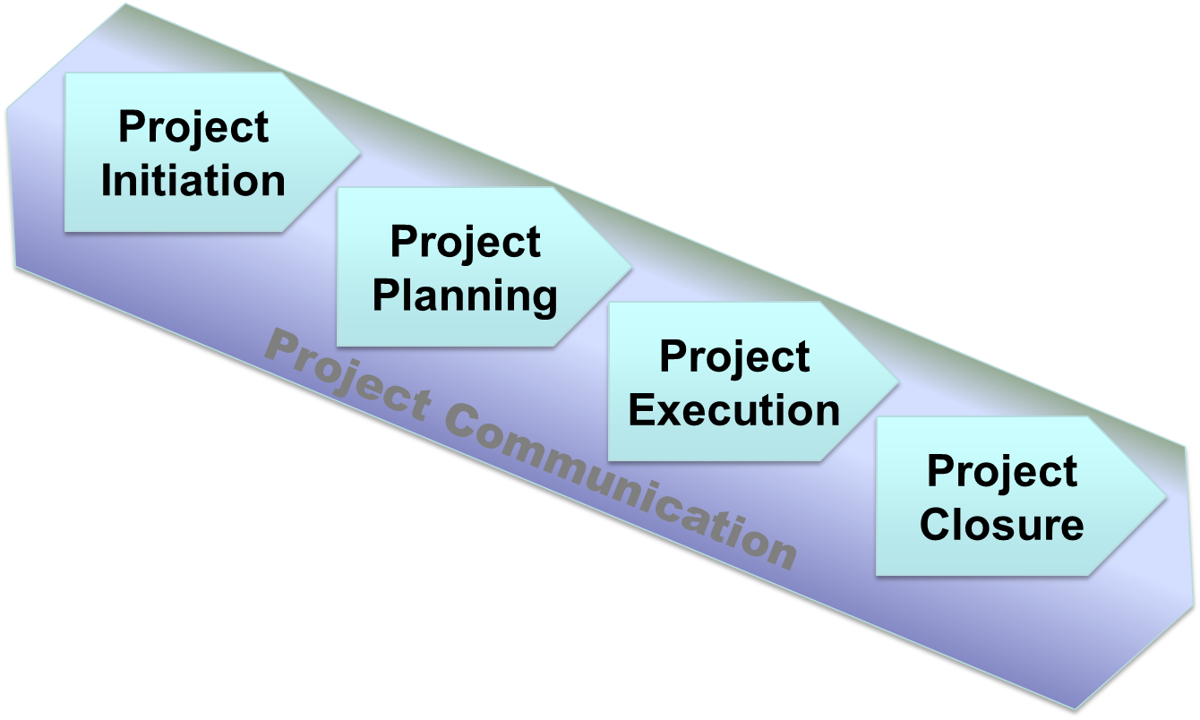
Systems Engineering’s Role in Program Lifecycle
Addresses the total lifecycle of a system
RIP: Rest in Peace
Notes:
SE looks at the system, it considers multiple characteristics across the full “Life Cycle” of the PROGRAM.
Source: http://professionalpractice.asme.org/ProductMgmt/Systems/Introduction.cfm

Slide 53
SE Tasks Risk Management
Project Initiation
How are things going?
Communicate risks to all affected parties
Monitor risk plans
Review regular status updates
Risk Identification
Risk Tracking
What can go wrong?
Proposed changes
Staffing
Process
Design
Supplier
Transition to production checklists
Test failures
Expectation shortfalls
Failure to perform
Negative trends
Issues list
…and ???
Risk Analysis
How big is the risk?
Likelihood
Possible consequences
Categories
Cost
Schedule
Technical
Identify the risk level using a Risk Reporting Matrix
Risk Mitigation Planning
How can you reduce the risk?
Avoid by eliminating the risk cause and/or consequence
Control the cause or consequence
Transfer the risk
Assume the risk level and continue current plan
Mitigation Plan Implementation
How can the mitigation plan be implemented?
Determine what planning, budget, and requirements changes are needed
Review with management and the customer
Incorporate the changes
Implement the plan
Notes:
Begins in the initiation stage and is continued throughout the entire lifecycle

Slide 54
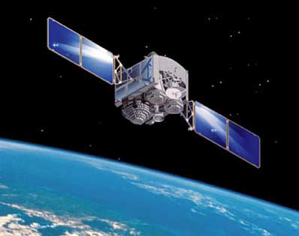
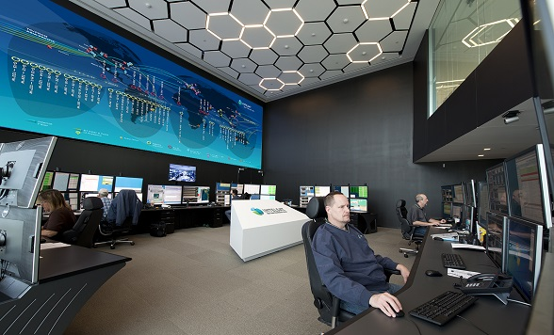

SE Tasks Requirements Definition
Project Initiation
Orbit 705 KM (23,130 Ft)
Descending Node 10:30 AM (Terra)
Ascending Node 1:30 PM (Aqua)
Sun-Synchronous
Mass 228.7 Kg
Scan Rate 20.3 RPM
Cross – Swath 2330 x 10 KM
Telescope 17.78 Cm diam
afocal int Field stop
Size 1.0 X 1.6 X 1.0 m
Power 162.4 W (single orbit ave)
Data Rate 10.6 Mbps (peak daytime)
6.1 Mbps (orbital Ave)
Design Life 6 years
Etc.
Etc.
SE: Systems Engineering RCS: Radar Cross Section
Notes:
Scope the project or product by defining needs, goals and objectives, mission or business case, high-level operational concepts, customer requirements, constraints, schedules, budgets, authority, and responsibility.
Develop operational concepts – scenarios for how your project or product might be used by the end user. Expand the concepts to cover all phases of the product or project life cycle.
Identify interfaces between your project or product and the rest of the world, clarifying boundaries, inputs, and outputs.
Write requirements to guide product design toward what your customers need and want.
Capture rationale (the reasons for the requirement’s existence) behind each requirement and expose potentially dangerous assumptions and incorrect facts.
Level requirements according to system and system sub-divisions, ensuring that all requirements are written at the right level and can be traced back to their origins.
Assess verification of each requirement, identifying the verification technique and facilities and equipment required.
Format requirements and supporting documentation to ensure that you have included each of the appropriate types of requirements and that your development team members can find all of the requirements they must meet.
Baseline requirements after validating that they are correct, complete, consistent, meet the project scope, and do not add unnecessary functionality or features not covered by the original scope.

Slide 55
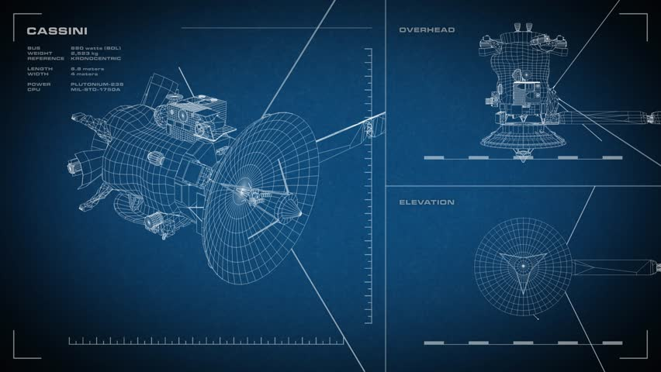
SE Tasks Requirements Analysis
Project Initiation
A Systems Engineering technical process that is a key bridge between the stakeholder requirements definition and architecture design processes
Requirements Analysis
Notes:
Source: http://professionalpractice.asme.org/ProductMgmt/Systems/Introduction.cfm

Slide 56
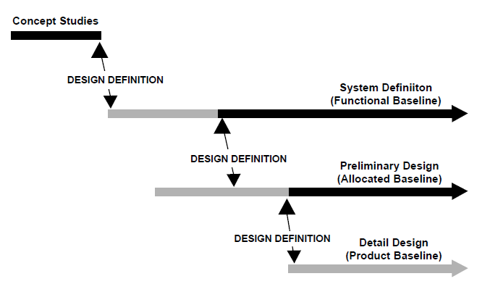
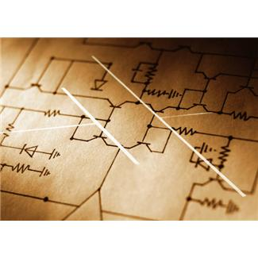
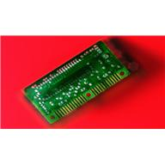
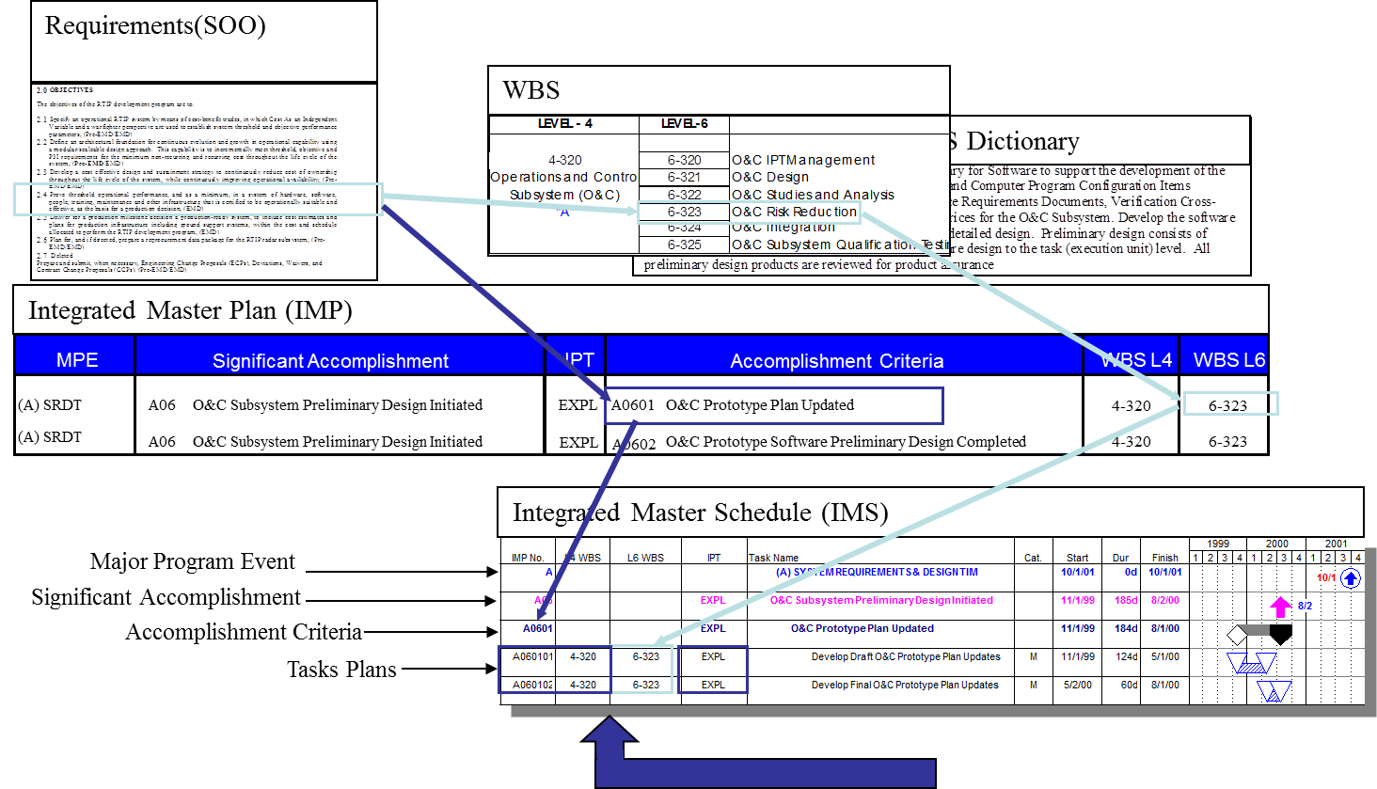
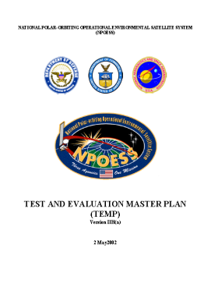
SE Tasks Cost & Schedule Inputs
Project Planning
Development Phasing
Technical Maturation
Task & Resource Allocation
Test & Evaluation
Notes:
Inputs of the strategy to achieve program objectives.

Slide 57
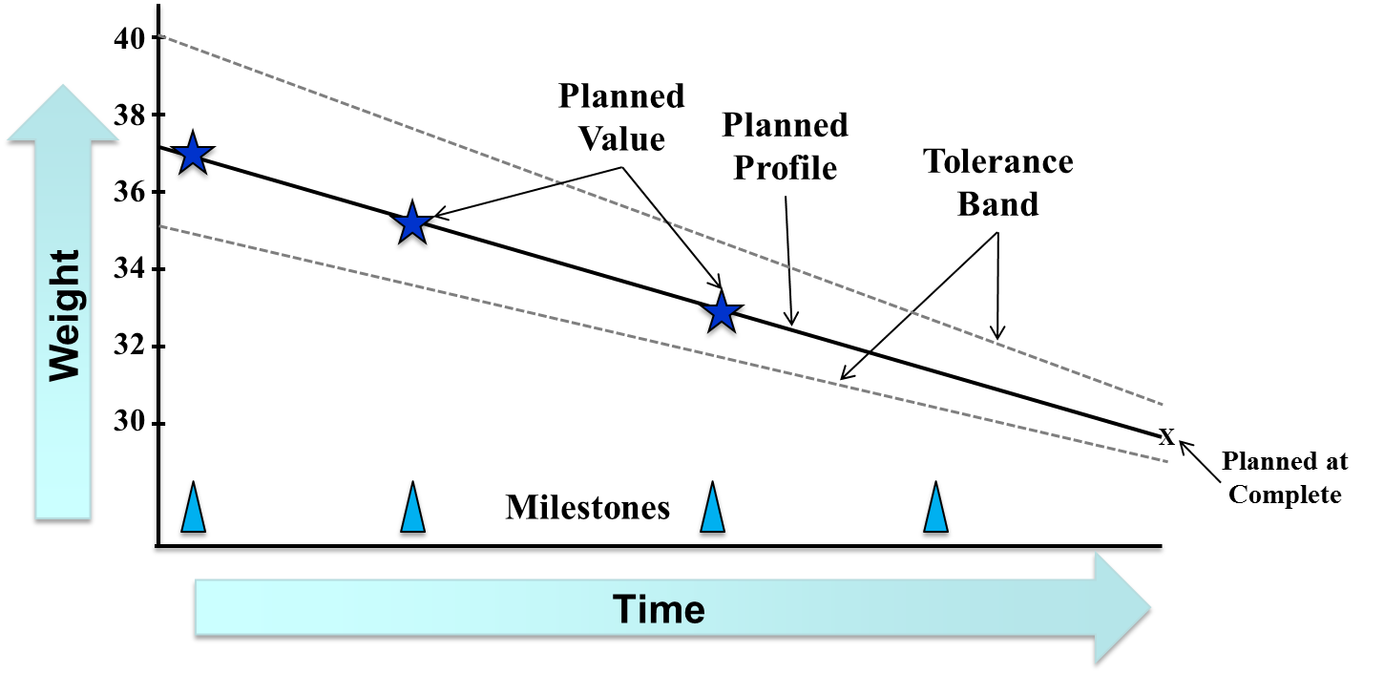
SE Tasks Design
Project Planning
Notes:
Source: http://professionalpractice.asme.org/ProductMgmt/Systems/Introduction.cfm

Slide 58
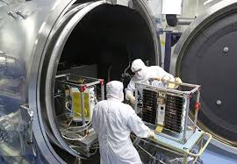
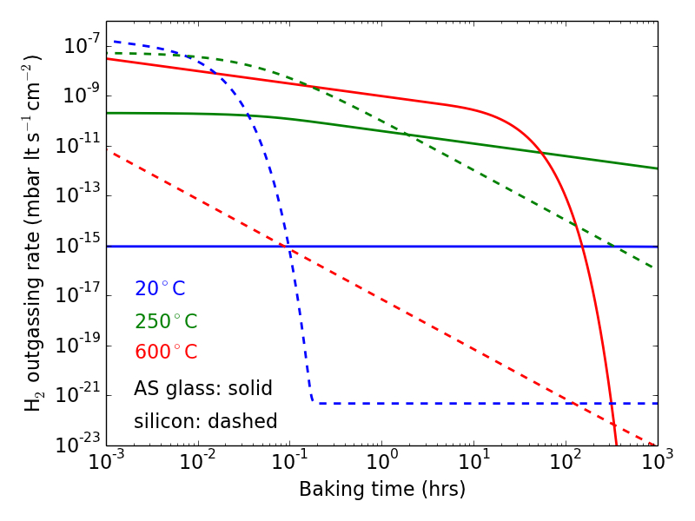
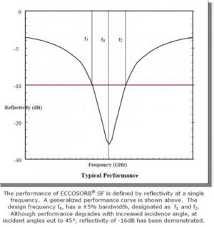
SE Tasks Analysis
Project Execution
Notes:
Considers the definition of requirements
Design
Analysis
Manufacturing
Test & verification
System support
Disposal
Source: http://professionalpractice.asme.org/ProductMgmt/Systems/Introduction.cfm

Slide 59
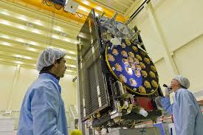

SE Tasks Manufacturing Support
Project Execution
Notes:
Considers the definition of requirements
Design
Analysis
Manufacturing
Test & verification
System support
Disposal
Source: http://professionalpractice.asme.org/ProductMgmt/Systems/Introduction.cfm

Slide 60

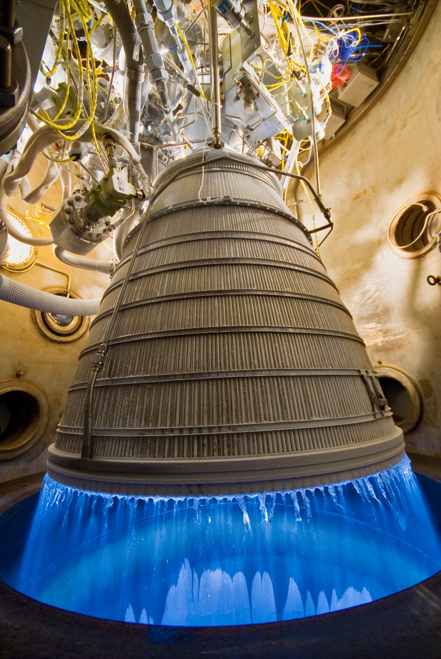
SE Tasks Test and Verification Support
Project Execution
Notes:
Considers the definition of requirements
Design
Analysis
Manufacturing
Test & verification
System support
Disposal
Source: http://professionalpractice.asme.org/ProductMgmt/Systems/Introduction.cfm

Slide 61

SE Tasks System Support
Project Execution
RAM
(Reliability, Availability and Maintainability)
Obsolescence
Upgrades
Notes:
Considers the definition of requirements
Design
Analysis
Manufacturing
Test & verification
System support
Disposal
Source: http://professionalpractice.asme.org/ProductMgmt/Systems/Introduction.cfm

Slide 62
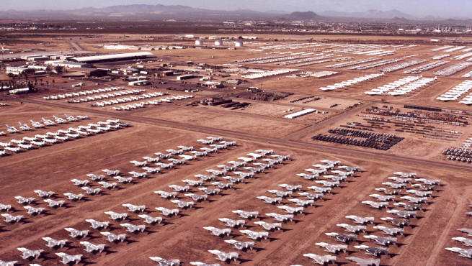
SE Tasks System Disposal Support
Project Closure
Storage
Disposal
Notes:
Considers the definition of requirements
Design
Analysis
Manufacturing
Test & verification
System support
Disposal
Source: http://professionalpractice.asme.org/ProductMgmt/Systems/Introduction.cfm

Slide 63
Systems Engineering Management
Controls the design process and provides baselines that coordinate
design efforts
Development Phasing
Baselines
Life Cycle Planning
Systems Engineering Management
Systems Engineering Process
Life Cycle Integration
Integrated Teaming
Provides a structure for solving design problems and tracking requirements flow through the design effort
Involves customers in the design process and ensures that the system
developed is viable throughout its life
Notes:
Phasing has two major purposes:
it controls the design effort
is the major connection between the technical management effort and the overall acquisition effort.
It controls the design effort by developing design baselines that govern each level of development.
It interfaces with acquisition management by providing key events in the development process, where design viability can be assessed.
The viability of the baselines developed is a major input for acquisition management Milestone (MS) decisions.
Systems engineering process is the heart of systems engineering management. Its purpose is to provide a structured but flexible process that transforms requirements into
specifications,
architectures,
and configuration baselines.
The discipline of this process provides the control and traceability to develop solutions that meet customer needs. The systems engineering process may be repeated one or more times during any phase of the development process.
Life cycle integration is necessary to ensure that the design solution is viable throughout the life of the system. It includes the planning associated with product and process development, as well as the integration of multiple functional concerns into the design and engineering process. In this manner, product cycle-times can be reduced, and the need for redesign and rework substantially reduced.
Source: SYSTEMS ENGINEERING
FUNDAMENTALS; SUPPLEMENTARY TEXT PREPARED BY THE DEFENSE ACQUISITION UNIVERSITY PRESS
FORT BELVOIR, VIRGINIA 22060-5565; Jan 2001; page 4

Slide 64
Development Phasing
Notes:
Development usually progresses through distinct levels or stages:
Concept level, which produces a system concept description (usually described in a concept study);
System level, which produces a system description in performance requirement terms; and
Subsystem/Component level, which produces f
first a set of subsystem and component product performance descriptions,
then a set of corresponding detailed descriptions of the products’ characteristics, essential for their production.
Source: SYSTEMS ENGINEERING
FUNDAMENTALS; SUPPLEMENTARY TEXT PREPARED BY THE DEFENSE ACQUISITION UNIVERSITY PRESS
FORT BELVOIR, VIRGINIA 22060-5565; Jan 2001; page 5

Slide 65
Life Cycle Integration
Life cycle integration is achieved through integrated development
Required by DoD policy
Called Integrated Product and Product Development (IPPD)
Utilizes interdisciplinary teams referred to as Integrated Product Teams (IPTs)
Notes:
Source: : SYSTEMS ENGINEERING
FUNDAMENTALS; SUPPLEMENTARY TEXT PREPARED BY THE DEFENSE ACQUISITION UNIVERSITY PRESS
FORT BELVOIR, VIRGINIA 22060-5565; Jan 2001; page 7

Slide 66
Integrated Product Teams
Multi-functional, integrated teams (IPTs):
Place balanced emphasis on product and process development
Require early involvement of all disciplines appropriate to the team task
Notes:
Source: : SYSTEMS ENGINEERING
FUNDAMENTALS; SUPPLEMENTARY TEXT PREPARED BY THE DEFENSE ACQUISITION UNIVERSITY PRESS
FORT BELVOIR, VIRGINIA 22060-5565; Jan 2001; page 7

Slide 67
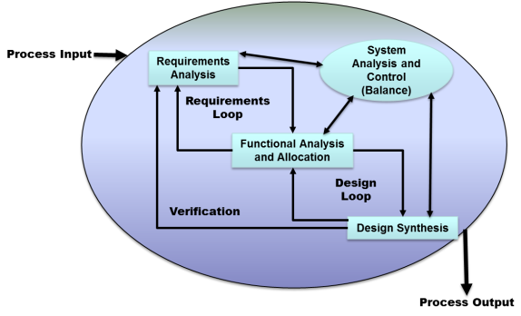
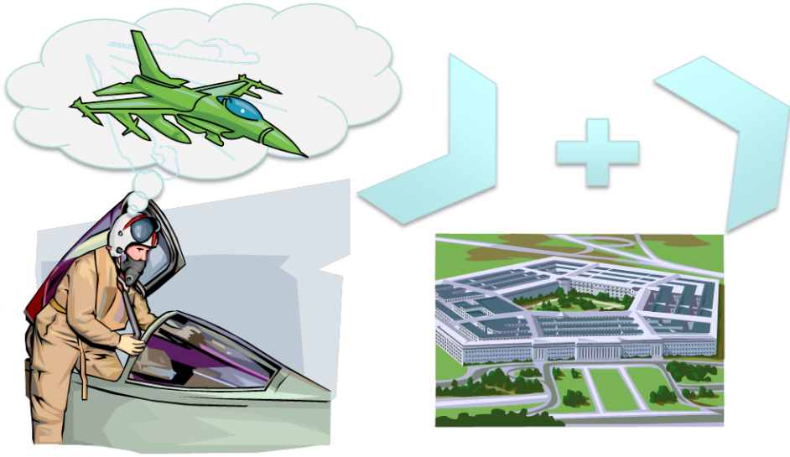
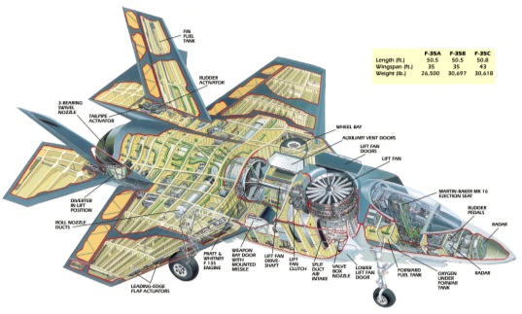
Integrated Product Teams (IPT)
Objectives of IPTs
Produce a design solution that satisfies initially defined requirements
Success depends on communicating that design solution clearly, effectively, and in a timely manner
Notes:
Source: : SYSTEMS ENGINEERING
FUNDAMENTALS; SUPPLEMENTARY TEXT PREPARED BY THE DEFENSE ACQUISITION UNIVERSITY PRESS
FORT BELVOIR, VIRGINIA 22060-5565; Jan 2001; page 7

Slide 68
Integrated Product Teams (IPT)
Design-level IPT members are chosen to meet the team objectives and have expertise in:
Technical management (systems engineering)
Life cycle functional areas – e.g. Design, Manufacturing, etc.
Technical specialty areas, such as safety, risk management, quality, etc.
When appropriate, business areas such as finance, cost/budget analysis, and contracting
Notes:
Life cycle functional areas - development, production and construction, deployment (fielding), operation, support, disposal, training, and verification
Source: : SYSTEMS ENGINEERING
FUNDAMENTALS; SUPPLEMENTARY TEXT PREPARED BY THE DEFENSE ACQUISITION UNIVERSITY PRESS
FORT BELVOIR, VIRGINIA 22060-5565; Jan 2001; page 7

Slide 69
Context of Controlling a Program
Systems Engineering
Program Control
System Design
Requirements Definition
Technical Solution Definition
Product Realization
Design Realization
Evaluation
Product Transition
Technical Management
Technical Planning
Technical Control
Technical Assessment
Technical Decision Analysis
Management Planning
Integrated Assessment
Schedule Management
Configuration Management
Resource Management
Documentation and Data Management
Acquisition Management
Planning
Risk Management
Configuration Management
Data Management
Assessment
Decision Analysis
Notes:
Source: NASA Systems Engineering Handbook NASA/SP-2007-6105 Rev1 page 4

Slide 70
PM and Program Systems Engineer Roles
Life-cycle Processes | Program Manager | Chief / Systems Engineer
Stakeholder Management | Primary | Support
Technical Planning | Support | Primary
Decision Analysis | Primary | Support
Technical Assessment (Includes Program Status: Technical Progress, Schedule & Cost Management) | Shared | Shared
Configuration Management | Primary | Support
Data Management | Primary | Support
Requirements Management | Support | Primary
Contract Management | Primary | Support
Requirements Analysis | Support | Primary
Architecture Design | Support | Primary
Implementation | Support | Primary
Risk Management | Primary | Support
Interface Management | Support | Primary
Integration | Support | Primary
Verification | Support | Primary
Validation | Shared | Shared
Notes:
Source: DAG 4.1.1. Systems Engineering in DoD Acquisition
https://acc.dau.mil/CommunityBrowser.aspx?id=332954

Slide 71
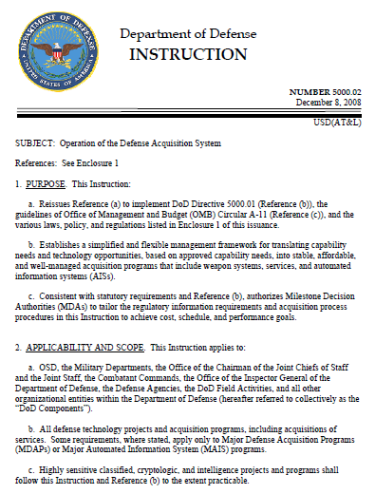
Statutory Compliance
5000.02, directs the use of SE across the acquisition life cycle
Notes:
“Rigorous systems engineering discipline is necessary to ensure that the Department of Defense meets the challenge of developing and maintaining needed warfighting capability. Systems engineering provides the integrating technical processes to define and balance system performance, cost, schedule, and risk within a family-of-systems and systems-of-systems context. Systems engineering shall be embedded in program planning and be designed to support the entire acquisition life cycle.”
Source: DoD Instruction 5000.02, Enclosure 12, paragraph 1

Slide 72
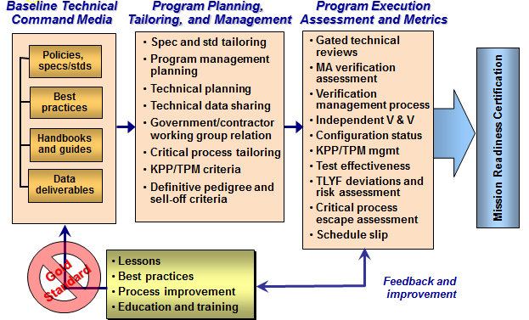
SMC SE Processes for Space
SMC: Space and Missile Systems Center SE: Systems Engineering KPP: Key Performance Parameters
TPM: Technical Performance Measure MA: Mission Assurance V&V: Validation & Verification TLYF: Test Like You Fly
Notes:
The uniqueness of the Process for SMC:
- The command media is SPACE specific
- Again the details are SPACE specific, but there is a nuance given pedigree and sell-off criteria for SPACE
- Mission Assurance and Test Like You Fly (TLYF) have very specific meanings for SPACE SYSTEMS!

Slide 73
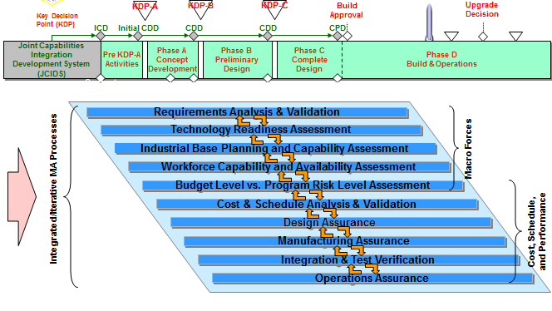
SE and Mission Assurance

Slide 74
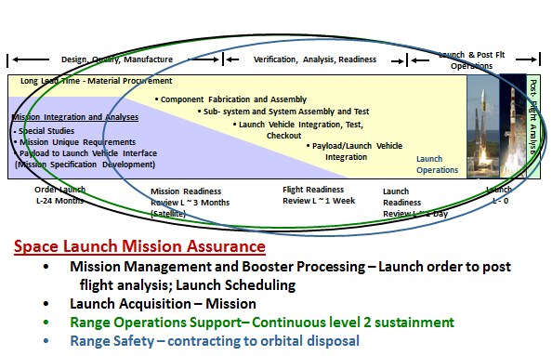
SE Space Launch Perspective

Slide 75
SE Functions
SE Model
Tools and Techniques

Slide 76
The “Vee” Model
Gather & Define Requirements
Feedback
Operational Acceptance
Decompose
& Define
System Design
System Integration & Verification
Integrate
& Verify
Detailed Design
Component Test
Component Engineering
Fabricate & Code
Notes:
The “Vee” model of systems engineering. This model is generally attributed to the National Aeronautics and Space Administration, which in 1988 saw a benefit in bending the waterfall model into the “V” shape for software development.
Source: Modified from K. Forsberg and H. Mooz, 1992, “The Relationship of Systems Engineering to the Project Life Cycle,” Engineering Management Journal4(3):36-43. Copyright 1992 by IEEE.

Slide 77
Key Systems Engineering Tools and Techniques
Systems Engineering Plan (SEP)
Integrated Master Plan (IMP)
Integrated Master Schedule (IMS)
Earned Value Management (EVM) and Work Breakdown Structure (WBS)
Technical Assessments (TPM)
Modeling and Simulation (M&S)
Technical Reviews
Test and Evaluation
General Knowledge Tools

Slide 78
Systems Engineering Plan (SEP)
No prescribed format for the SEP – however, it should address:
Overall requirements for the program
Systems engineering processes to be applied
Integration of SE into the program's IPTs
System's technical baseline approach
Event-driven timing, conduct, success criteria, and expected products of technical reviews
Participants in the SE Process (Who)
SE Processes and Products (What)
Facilities Enabling SE (Where)
SE Event Timing (When)
SE Decision Rationale (Why)
Tools Enabling SE (How)
Notes:
how systems engineering will support the translation of system capability needs into an effective, suitable product that is sustainable at an affordable cost
SEP contents
Introduction
1.1 Program Description and Applicable Documents
1.2 Program Status as of Date of This SEP
1.3 Approach for SEP Updates
2. Systems Engineering Application to Life Cycle Phases
2.1 System Capabilities, Requirements, and Design Considerations
• Capabilities to be Achieved
• Key Performance Parameters
• Statutory and Regulatory Requirements
• Certification Requirements
• Design Considerations
2.2 SE Organizational Integration
• Organization of IPTs
• Organizational Responsibilities
• Integration of SE into Program IPTs
• Technical Staffing and Hiring Plan
2.3 Systems Engineering Process
• Process Selection
• Process Improvement
• Tools and Resources
• Approach for Trades
2.4 Technical Management and Control
• Technical Baseline Management and Control (Strategy and Approach)
• Technical Review Plan (Strategy and Approach)
2.5 Integration with Other Program Management Control Efforts
• Acquisition Strategy
• Risk Management
• Integrated Master Plan
• Earned Value Management
• Contract Management
Source: DAG 4.5.1. Systems Engineering Plan (SEP)
Source: SYSTEMS ENGINEERING PLAN (SEP) PREPARATION GUIDE, VERSION 1.0 AUGUST 15, 2005 pg 9

Slide 79
A Fully Integrated Framework
Requirements(SOW)
The link is established between the IMS and the WBS at the task level
Work Breakdown Structure (WBS)
WBS Dictionary
Integrated Master Plan (IMP)
MPE
Significant Accomplishment
IPT
Accomplishment Criteria
WBS L4
WBS L6
(A) SRDT
A06
O&C Subsystem Preliminary Design Initiated
EXPL
A0601
O&C Prototype Plan Updated
4-320
6-323
(A) SRDT
A06
O&C Subsystem Preliminary Design Initiated
EXPL
A0602
O&C Prototype Software Preliminary Design Completed
4-320
6-323
Integrated Master Schedule (IMS)
Major Program Event
Significant Accomplishment
Accomplishment Criteria
Tasks Plans
The Task contains the entire Life Cycle of each IPT processes that lead to the IMS Products. Schedules Will Be Linked to Identify Critical Path and Slack, and to Form the Basis for Schedule Risk Analysis
IMP/IMS Common Numbering
Notes:
Event-driven schedule ensures all tasks are planned and accomplished in a rational and logical order
Provides an overarching framework against which all work is accomplished
Documents all tasks required to deliver a high quality product and facilitate success throughout the life cycle
Provides an understanding of the scope of work required and the likely structure of the program
Depicts likely progression of work, with the most emphasis on the current or upcoming phase
Identify dependencies, which may be performed by different organizations
Depends on a fundamental understanding of the technical products required and the time necessary to develop these products
Uses a work breakdown structure (WBS) identifying all major systems and subsystems down to a configuration item level
Captures all activities required to define, design, integrate, test, evaluate and deliver system elements
Further defined in terms of calendar time and resources to complete and assembled into an integrated, event-based, and resource-based schedule

Slide 80
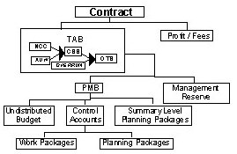
Earned Value Management (EVM) and Work Breakdown Structure (WBS)
WBS and IMS form the basis of the Performance Measurement Baseline (PMB), the foundation of EVM
PMB is simply a time-phased budget plan for accomplishing work, against which contract performance is measured
Notes:
(note: EVM will be covered as a separate subject)
Source: DAG 4.5.4. Earned Value Management (EVM) and Work Breakdown Structure (WBS

Slide 81
WBS
WBS is a product oriented family tree composed of hardware, software, services, data and facilities that completely define a program
Defined, developed, and maintained throughout the system life cycle based on sound application of the SE process
Notes:
(note: EVM will be covered as a separate subject)
Supports:
Program and technical planning
Cost estimation and budget formulation
Schedule estimation
Statements of work and specification of contract line items
Progress status reporting and problem analysis
Source: DAG 4.5.4. Earned Value Management (EVM) and Work Breakdown Structure (WBS

Slide 82
Types of Technical Assessments
Technical Performance Measurements (TPMs) and Critical Technical Parameters (CTPs)
Measure compliance with system performance requirements
Used with WBS and EVMS to balance cost, schedule, and performance
Used to track performance measurement in support of T&E
Assessment of Operational Test Readiness (AOTR)
Uses Data Acquisition and Processing System (DAPS) to provide insight into the readiness of a program to proceed with current and future program execution
Notes:
Source: DAG 4.5.6. Types of Technical Assessments

Slide 83


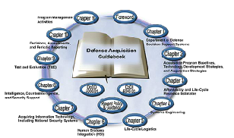

Defense Acquisition Program Support (DAPS)
Multifunctional team conducts Program Support Reviews (PSRs), in accordance with DAG, assisting program managers prepare for Milestone Decisions
OSD PSR team
SE
PM
PK
FM
Notes:
“PSRs shall be conducted by cross-functional and cross-organizational teams appropriate to the program and situation. PSRs for ACAT ID and IAM programs shall be planned by the Director, Systems and Software Engineering to support OIPT program reviews, at other times as directed by the USD(AT&L), and in response to requests from PMs.”
Conducted to provide insight into current and future program execution using the "Defense Acquisition Program Support (DAPS) methodology"
OSD PSR teams apply DAPS methodology to MDAPs approaching a Defense Acquisition Board (DAB)
Identify program strengths, problems, risks and other issues
Categorize and relate defined findings (triggering vs. symptomatic)
Prioritize these findings with respect to program impact
Develop actionable recommendations that address final program findings (focus on root causes)
Results provide:
Actionable recommendations to Program Management Offices PMOs) to facilitate successful execution of their programs
Support to Under Secretary of Defense for Acquisition, Technology and Logistics decision-making process for MDAP and Major Automated Information System programs, and
A means to conduct a systemic analysis of programs to identify opportunities to improve acquisition performance through changes in policy, education, and effective use of systems engineering
Source: DAG 4.5.6.2. Program Support Review (PSR)

Slide 84
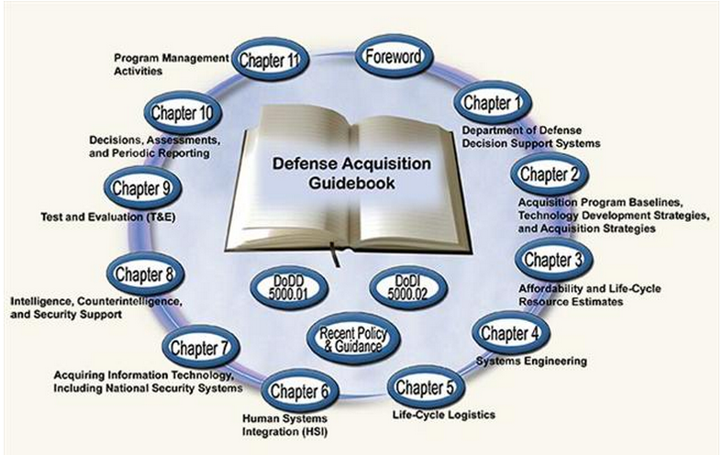
Defense Acquisition Guidebook
Defense Acquisition best practices captured in the Defense Acquisition Guidebook (DAG) as a reference source supporting their management responsibilities
Notes:
The DAG is a great source document for all Programmatic Direction. https://dag.dau.mil/Pages/Default.aspx
Source: DAG 4.5.6.2. Program Support Review (PSR)

Slide 85
Trade Studies
Establish the study problem
Develop a problem statement
Identify requirements and constraints
Establish analysis level of detail
Review inputs
Check requirements and constraints for completeness and conflicts
Develop customer-team communication
Select and set up methodology
Choose trade-off methodology
Develop and quantify criteria, including weights where appropriate
Identify and select alternatives
Identify alternatives
Select viable candidates for study
Analyze results
Calculate relative value based on chosen methodology
Evaluate alternatives
Perform sensitivity analysis
Select preferred alternative
Re-evaluate results
Measure performance
Develop models and measurements of merit
Develop values for viable candidates
Document process and results
Notes:
Used in support of decision making throughout the life cycle of a program
Systematic examination of criteria to determine which is optimal and to be recommended among:
Operational capabilities
Functional, and performance requirements
Design alternatives and related:
Manufacturing
Testing
Support processes
Program schedule
Life-cycle cost
Most trade studies are not strictly formal or informal; usually they fall somewhere in between these two extremes. As a general rule, formal trade studies are indicated for high-value, high-risk or other high-impact decisions. Not all trade studies should follow the full rigor of a formal process, but should be tailored to the specific circumstances of the program such as:
Likelihood or severity of programmatic risk,
Objectivity and quantitative data used,
Detail in available data, and
Time, effort and money needed to conduct the trade study.
Additional information on conducting trade studies is available in a Defense Acquisition University (DAU) Continuous Learning Module CLE 026, "The Preferred Practices Approach to Trade Studies".
Source: DAG 4.5.7. Trade Studies

Slide 86
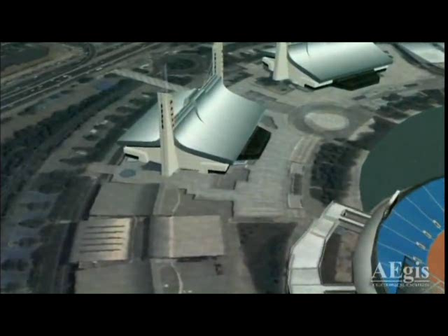
Modeling and Simulation (M&S)
“…formalized application of modeling to support system requirements, design, analysis, verification and validation, beginning in the conceptual design phase and continuing throughout development and later life cycle phases.”
Challenges in achieving effective M&S use include:
M&S not planned and managed with sufficient care
M&S capabilities/limitations are not adequately understood
Credible models include physical capabilities, natural phenomena, and physics-based interactions
Less credible models include human behavior, reliability, and emergent behaviors of complex systems
Notes:
Typical programs use many synthetic environments and M&S to:
Develop the system concept
Design the system, including its sustainment
Assess alternatives throughout the development cycle
Integrate the system
Test the system to verify it meets requirements
Support system introduction, sustainment and evolution
Programs should involve their Operational Test Authority (OTA) in M&S planning to support both developmental test and operational test objectives
M&S capabilities and limitations are often inadequately understood, and M&S is sometimes not planned and/or managed with sufficient care. Although we can credibly model many things we understand well (e.g., physical capabilities, natural phenomena, and physics-based interactions), it is much more difficult to reliably represent things we do not understand well (e.g., human behavior, reliability, and emergent behaviors of complex systems). M&S capability involves not just the software tools themselves, but the data that feeds them; the computing platforms that execute them; the standards, middleware and networks that may interconnect them; the encryption capabilities and security constraints that protect them; and, most importantly, the people that plan, develop, integrate, verify, validate, accredit and use them. Deficiencies in any of these present a risk to a program. Thus acquisition managers should approach the use of M&S wisely and plan carefully.
The following links provide policy and guidance
Source: DAG 4.5.8. Modeling and Simulation (M&S)
Source: MODELING AND SIMULATION GUIDANCE FOR THE ACQUISITION WORKFORCE, VERSION 1.0, OCTOBER 2008, Department of Defense, Office of the Deputy Under Secretary of Defense for Acquisition and Technology Pgs 7-8
Viseo Source: NTSA http://www.youtube.com/user/NTSAToday#p/f/1/X-6zxImekOE Modeling & Simulation 101 From: NTSAToday | August 12, 2009 last visited 13 Oct 2010

Slide 87
Technical Reviews
User Needs
Technology Opportunities & Resources
A
B
C
Material Solution Analysis
Material Development Decision
Technology Maturation & Risk Reduction
Engineering and Manufacturing Development
Production and Deployment
Operations and Support
Post- PDR A
Post- CDR A
FRP –Decision Review
Program Reviews with a technical basis
IBR
IBR
TRA
IBR
TRA
OTRR
Technical Reviews
IBR
ITR
ASR
SRR
SFR
PDR
CDR
TRR
SVR /FCA /PRR
PCA
ISR
Technical Baseline
System Design Specification
Allocated Baseline
Product Baseline
Preferred System Concept
System Functional Baseline
Initial Product Baseline
Technology Readiness Assessment
Technical Reviews
Program Reviews
Decision Point
Milestone Review
AOTR - Assessment of Operational Test Readiness
ASR - Alternative System Review
CDR - Critical Design Review
FCA - Functional Configuration Audit
FRP - Full Rate Production
IBR - Integrated Baseline Review
ISR - In Service Review
ITR - Initial Technical Review
OTRR - Operational Test Readiness Review
PCA - Physical Configuration Audit
PDR - Preliminary Design Review
PRR - Production Readiness Review
SFR - System Functional Review
SRR - System Requirements Review
SVR - System Verification Review
TRA - Technology Readiness Assessment
TRR - Test Readiness Review
* PDR may occur after MS B for less than MDAP
Notes:
Source: : DAG 4.3. Systems Engineering Activities in the System Life Cycle

Slide 88
Commonly Used Technical Reviews
Review | Function
Initial Technical Review | Ensures technical baseline is sufficiently rigorous to support valid cost estimate (with acceptable cost risk)
Alternative Systems Review | Demonstrates the preferred concept is cost effective, affordable, operationally effective and suitable; and can be developed to provide a timely solution at an acceptable level of risk
System Requirements Review | Determines the direction and progress of the systems engineering effort and the degree of convergence upon a balanced and complete configuration
Technology Readiness Assessment | Statutory requirement for Major Defense Acquisition Programs (MDAPs) establishes the maturity of critical technology elements
Integrated Baseline Review | Mandated by (DFARS) clause 252.234-7002 - establishes a mutual understanding of the project performance measurement baseline
System Functional Review | Ensure that a system can proceed into preliminary design, that all system requirements and functional performance requirements derived from the Capability Development Document are defined and consistent with program budget, schedule, risk, and other system constraints
Sources: DAG 4.5.9. Summary of Technical Reviews
Notes:
These checklists are available on the Systems Engineering Community of Practice
Sources: DAG 4.5.9. Summary of Technical Reviews
ACQuipedia Article – ITR https://acc.dau.mil/CommunityBrowser.aspx?id=28939 last visited 11 Oct 2010
ACQuipedia Article – ASR https://acc.dau.mil/CommunityBrowser.aspx?id=28827 last visited 11 Oct 2010
ACQuipedia Article – SRR https://acc.dau.mil/ILC_SRR last visited 11 Oct 2010
ACQuipedia Article – TRA https://acc.dau.mil/CommunityBrowser.aspx?id=29067 last visited 11 Oct 2010
ACQuipedia Article – IBR https://acc.dau.mil/ILC_IBR last visited 11 Oct 2010
ACQuipedia Article – SFR https://acc.dau.mil/CommunityBrowser.aspx?id=29035 last visited 11 Oct 2010

Slide 89
Commonly Used Technical Reviews
Review | Function
Preliminary Design Review | Confirms the preliminary design logically follows the SFR findings and meets the requirements
Critical Design Review | Ensure that a system can proceed into fabrication, demonstration, and test and can meet stated performance requirements within cost, schedule, risk, and other system constraints
Test Readiness Review | Ensure that a subsystem or system is ready to proceed into formal test
Flight Readiness Review | Subset of the Test Readiness Review, and is applicable only to aviation programs. The FRR assesses the readiness to initiate and conduct flight tests or flight operations
System Verification Review | Assesses system functionality and determines if it meets the functional requirements as documented in the functional baseline
Sources: DAG 4.5.9. Summary of Technical Reviews
Notes:
These checklists are available on the Systems Engineering Community of Practice
Source: DAG 4.5.9. Summary of Technical Reviews
ACQuipedia Article – PDR https://acc.dau.mil/CommunityBrowser.aspx?id=308742 last visited 11 Oct 2010
ACQuipedia Article – CDR https://acc.dau.mil/ILC_CDR last visited 11 Oct 2010
ACQuipedia Article –TRR https://acc.dau.mil/ILC_TRR last visited 11 Oct 2010
ACQuipedia Article –FFR https://acc.dau.mil/CommunityBrowser.aspx?id=294561 last visited 11 Oct 2010
ACQuipedia Article –SVR https://acc.dau.mil/CommunityBrowser.aspx?id=294561 last visited 11 Oct 2010

Slide 90
Commonly Used Technical Reviews
Review | Function
Functional Configuration Audit | Assesses the system final product, as evidenced in its production configuration, and determines if it meets the functional requirements (derived from the CDD and draft CPD) documented in the Functional, Allocated, and Product Baselines
Production Readiness Review | Determines if production or production preparations have unacceptable risks that might breach thresholds of schedule, performance, cost, or other established criteria
Operational Test Readiness Review | Ensure that the production configuration system can proceed into Initial Operational Test and Evaluation (IOT&E) with a high probability of success
Physical Configuration Audit | Physical examination of the actual configuration of the item being produced. It verifies that the related design documentation matches the item as specified in the contract
In-Service Review | Ensure that the system under review is operationally employed with well-understood and managed risk. It provides an assessment of risk, readiness, technical status, and trends in a measurable form
Sources: DAG 4.5.9. Summary of Technical Reviews
Notes:
These checklists are available on the Systems Engineering Community of Practice
Source: DAG 4.5.9. Summary of Technical Reviews
ACQuipedia Article – FCA https://learn.dau.mil/CourseWare/800840_4/media/svr_factsheet.pdf last visited 11 Oct 2010
ACQuipedia Article – PRR https://acc.dau.mil/CommunityBrowser.aspx?id=294561 last visited 11 Oct 2010
ACQuipedia Article –OTRR https://acc.dau.mil/CommunityBrowser.aspx?id=28979 last visited 11 Oct 2010
ACQuipedia Article –PCA https://acc.dau.mil/CommunityBrowser.aspx?id=28990 last visited 11 Oct 2010
ACQuipedia Article –ISR https://acc.dau.mil/CommunityBrowser.aspx?id=294561 last visited 11 Oct 2010

Slide 91

“Back to Basics”
Lost Space Assets During the 1990s/early 2000’s
Reduced Government and Contractor Mission Assurance
$$ and engineering resources
The 90’s Saw a Number of Interrelated “New Directions” for the Development of Space Systems
DoD “Acquisition Reform”
Reduced reliance on specs/standards
Deferred largely to commercial “best practices”
NASA “Faster, Better, Cheaper”
Commercial “Best Practices”
Reduced Effectiveness of Acquisition Practices of the 1990s

Slide 92
Root Cause – Why Things Went Awry
Acquisition agents relegated to a “trust and see” role
Risk, especially during development, transferred largely to contractors
Systems becoming increasingly more complex
Cost and schedule became the focus of
risk management
Deviation from conventional practices
Major issue with insurance brokers
Specs and standards loosely applied
Commercial best practices assumed to be
a “proven” alternative
MA largely decoupled from design process
Design audits, failure modes and effects criticality analysis (FMECA), and preliminary/critical design audits (PDA/CDA) considered “burdensome”
SV Cost as Function of Complexity
(Small Sat Model)
1000
Success
Failure
100
Space Vehicle Cost (FY97 $M)
10
1
0
0.1
0.2
0.3
0.4
0.5
0.6
0.7
0.8
0.9
1
Failures Provide Evidence of
“No Fly” Zone
Complexity Index
SOURCE: D. Bearden

Slide 93
Root Cause – Why Things Went Awry
Quality and review processes dramatically curtailed
QA and inspection reduced (especially at subcontractor level)
Vigorous pedigree reviews “off the table”
Test discipline greatly relaxed
Thoroughness of workmanship screens reduced

Slide 94

Factory Anomaly Failure Rates
Late build-cycle failures post-1995 have shown a dramatic increase
System test failures are up 39%
Correlates with the 57% increase in orbital failures
The nature of factory defects has shifted
Current defects identified in system test primarily involve design and software
These findings are echoed by the Launch Vehicle Broad Area Review
Late Build-Cycle Failures
12
Pre-1995
10
Post-1995
8
Anomalies / SV
6
4
2
0
System
1st Year On-orbit
System Test Failure Cause
6
Pre-1995
5
Post-1995
4
Anomalies / SV
3
2
1
0
Design
Part
Workmanship
Processes Prior to 1995 Were More Effective at Minimizing Late Build-cycle Problems

Slide 95
Example: Unit Thermal Test Erosion
Unit Test Impact on System Failures
Data shows reducing thermal cycles has an effect on problems during system thermal testing
Note: with increasing complexity comes increasing harness and thermal equipment problems. Unit level testing will not solve this system TV problem
20.00
18.00
MIL-STD-1540B Baseline
16.00
14.00
MIL-STD-1540E Baseline
12.00
System Thermal Failures
(Normalized to 120K Parts)
10.00
8.00
6.00
4.00
2.00
0.00
0.00
5.00
10.00
15.00
20.00
Equiv Cycles Unit Thermal Cycles (85 deg C)
L
M
N
O
K
M
Equiv Cycles = Test cycles*(Delta ºC/85)²
P
J
G
C
D
E
Reducing unit thermal cycles results in increased system test defects

Slide 96
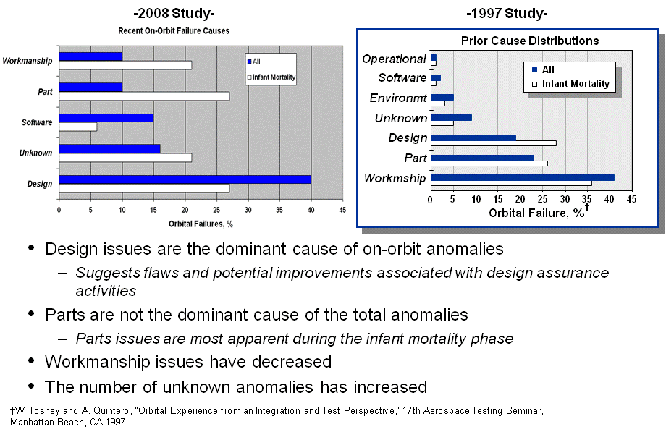
Post-97 Root Causes of Anomalies
Design issues are the dominant cause of on-orbit anomalies
Suggests flaws and potential improvements associated with design assurance activities
Parts are not the dominant cause of total anomalies
Parts issues are most apparent during infant mortality—a proto-qual and testing issue
Workmanship issues have decreased
More attention to testing and QA/MA practices
The number of unknown anomalies has increased
Lack of solid understanding of “as built” configuration
Software is emerging as a leading source of anomalies

Slide 97
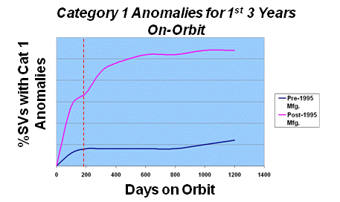
Root Causes of Orbital Anomalies
Infant Mortality dramatically increased
Secondary rise in failures due to …..
Recent assessment of orbital failure trends identifies increased number of early failures
Higher rate due to factors such as production maturity, increased complexity, and lack of verification

Slide 98
Significant Degradation in Testing Practices
Environmental Test Thoroughness Assessment
Test Risk Erosion by Assembly Level
Test Erosion Since 1995
100
SV
Program
Unit Test
System Test
Thermal
Shock
Aco/Vib
Burn-in
Thermal
Shock
Aco
Pre-1995
B
90
D
Post-1995
C
80
E
Environmental Test Thoroughness
F
70
A
G
60
H
I
50
J
NRO Programs
SMC Programs
Added effectiveness
Marginal Effectiveness
M-S-1540 Baseline
Lowest Effectiveness
Every NSS Satellite Program Showed a Decline in Test Rigor, Even on New, More Complex Proto-flight Designs

Slide 99
Mar 2010 Space Class A Safety Investigation Board (SIB) Recommendations
Unclassified
Rec # OPR Description
Rec 1 SMC Verify Previous Interface Specs Are Valid for New Applications & Configurations
Rec 2 SMC Retain all Requirements & Specs of Previous App or Conduct by thorough
analysis/test with peer review before changes
Rec 3 SMC Work Preparations for Major Reviews include critical questioning, independent
assessment & in-depth understanding of TEST&ANALYSIS
Rec 4 SMC Major Tech Reviews include critical question, independent assessment &
in-depth understanding of TEST&ANALYSIS
Rec 5 SMC Identify SMEs from all space disciplines & ensure they are sufficiently dedicated to a program/project to discover flaw early in requirements definition, interface specs, design & testing phases
Rec 6 SMC Perform delta PDR & CDR IAW established guidance
Rec 7 SMC At all major reviews, all space disciplines experienced SMEs to be actively engaged
Rec 8 SMC Ensure FFRDC President review team, independent of Program office, perform an early, in-depth technical readiness review to assess the Program office conclusions
Rec 9 SMC Perform an assessment of the IRRT for mismatches of responsibility & resources in order to best match manning responsibilities to best expertise
ORS-1 SMC Ensure there is a system engineer for each program to ensure overall system performance & compatibility
ORS-2 SMC Ensure Prime CTRs are incentivized/motivated to include all payload subcontractors/suppliers in the requirements definition, interface specs and system testing
ORS-3 SMC Develop standard TYLF definition & compliance
ORS-4 SMC Ensure FFRDC President review team complete findings prior to S/V shipment to range

Slide 100
How Much Mission Assurance Do We Need?
How much risk do we want to manage/when?
High stakes: a failure may result in a gap in national security, loss of a decade of effort and Billions of dollars, particularly given the “fragile” condition of space systems.
“One Strike and You’re Out” demands high reliability
How much does it cost?
7.5% for traditional government contracts¹
Cost of “Specs and Standards” are ∼5%²
Government specs/stds supplements KTR’s
internal business practices
3% for Faster-Better-Cheaper (Class C) contracts³
What Does it Buy?
A methodical MA process reduces catastrophic mishap rate over program phases roughly as follows: Before PDR 6%; Between PDR and CDR 7%; Between CDR and I&T 5%; After I&T 2%; Total 20% reduction in likelihood of Mission Failure.
Resources allocated to MA vary according to mission classes
Risk Reduction over Program Lifetime
J. R. Wertz, et. al., Space Mission Analysis and Design, 2nd Ed. Section 20.3
Based on studies by RAND, GAO, Coopers & Lybrand, Aerospace “Quicklook”, etc.
L. Sarsfield, The Cosmos on a Shoestring, Appendix A
Notes:
This chart is intended to reframe Gen Kehler’s question in terms of Risk and Cost.
The basic messages in bullet 1 are that space systems are critical elements of national security that require high reliability and that MA processes applied earlier are more effective.
The message in bullet two is that the contractual cost (to industry) of applying/integrating MA processes is on the order of 7.5% of program costs. This does not include cost of government/FFRDC. The cost of a Aerospace estimates that cost to implement iMAT on major programs is on the order of 1-2 STE (~500K). Also of note is the table on the lower right which reflects the positive impact of integrating MA processes early in the acquisition life cycle.
Another voice over message is that MA is most effective when baked into the entire acquisition life cycle through expert, experienced personnel diligently applying proven processes and tools. This is Aerospace’s role…
Can we put together a chart or bullet that states what MA has “saved” enterprise in terms of dollars/capability? This could also be used to support Aerospace “value” on later chart. (Rami/Mike?)
The bottom line is that we cannot really afford not to integrate MA throughout the acquisition life cycle.

Slide 101
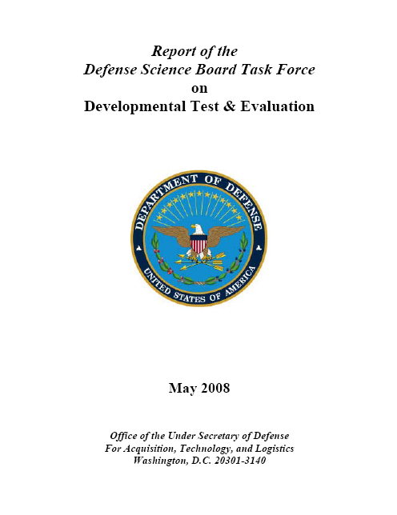


Test and Evaluation
“Approximately 50% of programs completing IOT&E since 2000 have been assessed as not operationally effective and/or suitable.”
2008 DSB Report on Developmental Test and Evaluation
“. . .beginning production before successfully demonstrating that the weapon system will work as intended increases the potential for discovering costly design changes…and usually requires substantial modification costs at a later time.”
2008 GAO Assessments of Selected Weapon Programs
IOT&E: Initial Operation Test & Evaluation DSB: Defense Sciences Board GAO: Government Accountability Office
Notes:
Source: ITEA Symposium September 14, 2010 Edward Greer Director, Developmental Test & Evaluation Slide #4

Slide 102
T&E Purpose
“The fundamental purpose of test is to provide knowledge to assist in managing the risks involved in developing, producing, operating, and sustaining systems and capabilities.”
Measures both system and capability development
Provides knowledge of system capabilities and limitations
Improving the system performance
Optimizing system use in operations
Addresses development and assessment of weapons support equipment
Notes:
An integral part of the Systems Engineering Process
Critical feedback loop – opportunity to assess engineering products, fix system deficiencies, execute risk reduction strategies and provide information to decision makers
Source: DoDI 5000.02, December 8, 2008 page 50

Slide 103
Effective T&E
Involves experienced testers and evaluators early on
Adequate planning
Seamless integration of test activities
Leverages modeling and simulation activities appropriately
Covers the entire life cycle of the product
Developmental Test and Evaluation (DT&E)
Operational Test and Evaluation (OT&E)
Live Fire Test and Evaluation (LFT&E)
Performance and Acceptance Testing and Evaluation (PAT&E) to validate system performance
Follow-on Test and Evaluation (FOT&E)
Notes:
Effective T&E is a continuum of integrated activities. The PM should develop an integrated T&E Strategy for Developmental Test and Evaluation (DT&E), Operational Test and Evaluation (OT&E), Live Fire Test and Evaluation (LFT&E), performance and acceptance testing to validate system performance and ensure the product provides measurable improvement to operational capabilities. This includes integration of modeling and simulation activities with contractor and government conducted testing.
T&E is event driven, rather than schedule driven, within the program's overall acquisition strategy. This allows for realistic durations to accomplish planned T&E events, fix system deficiencies, execute risk reduction strategies and report the results to decision makers.
Source: https://learn.dau.mil/html/scorm12/course/course_index.jsp?course_id=1&scorm_version=3&roster_id=-329.563803158804&version=18&course_prefix=ACQ&course_number=101&course_suffix=&mode=browse&course_name=Fundamentals%20of%20Systems%20Acquisition%20Management&mode_id=10&section_id= slide 9

Slide 104
T&E Planning
Objectives:
Determine types and quantity of data to be collected
Identify Modeling and Simulation (M&S) opportunities to anticipate test risks/results
Ensure safe test procedures
Establish environmental protections
Identify resources and schedule
Codified in two major T&E Planning Documents:
Test and Evaluation Strategy (TES)
Test and Evaluation Master Plan (TEMP)
Notes:
DoDD 5000.01 provides principles and policies governing test and evaluation in the Defense Acquisition System.
The only exceptions are: Investigational drugs; Biologicals; Medical devices
DoDI 5000.02 identifies the flow of the T&E activities within the development process and states that test activities shall be part of a Test and Evaluation strategy to:
Provide information regarding risk and risk mitigation.
Provide empirical data to validate models and simulations.
Permit an assessment of the attainment of technical performance specifications and system maturity.
The Defense Acquisition Guidebook (DAG) provides the acquisition professional discretionary best practices tailored to meet the needs of their respective programs. The chapter in the Defense Acquisition Guidebook (DAG) entitled, "Integrated Test and Evaluation", aids the Program Manager in developing a robust, integrated T&E strategy.
Source: DAG 9.6.1. Test and Evaluation Strategy (TES)

Slide 105
TES
Test And Evaluation Strategy (TES)
Concept for tests and evaluations throughout the program life cycle
Submitted for approval prior to Milestone A (MS A)
Evolves into the TEMP at MSB
Key attributes of successful TES
Early involvement of testers and evaluators with technical, operational, and programmatic expertise
Consistent with the Technology Development Strategy (TDS) and Initial Capabilities Document (ICD)
Satisfies statutory requirement for a TDS test plan ensuring goals and exit criteria for technology demonstrations are met
Notes:
starting with Technology Development and continuing through Engineering and Manufacturing Development (EMD) into Production and Deployment DoDD 5000.01 provides principles and policies governing test and evaluation in the Defense Acquisition System.
DoDI 5000.02 identifies the flow of the T&E activities within the development process and states that test activities shall be part of a Test and Evaluation strategy to:
Provide information regarding risk and risk mitigation.
Provide empirical data to validate models and simulations.
Permit an assessment of the attainment of technical performance specifications and system maturity.
The Defense Acquisition Guidebook (DAG) provides the acquisition professional discretionary best practices tailored to meet the needs of their respective programs. The chapter in the Defense Acquisition Guidebook (DAG) entitled, "Integrated Test and Evaluation", aids the Program Manager in developing a robust, integrated T&E strategy.
Source: DAG 9.6.1. Test and Evaluation Strategy (TES)
Source: Section 235 of P.L. 107-314

Slide 106
Test and Evaluation Master Plan (TEMP)
Describes T&E planning from component development through operational T&E into production and acceptance
Identifies required type and amount of test and evaluation events, along with resource requirements
Considered a contract among the PM, OSD, and the T&E activities
T&E: Test & Evaluation PM: Program Manager OSD: Office of the Secretary of Defense
Notes:
Program Manager (PM), with T&E WIPT support is responsible for producing the TEMP
Integrates T&E with acquisition strategy and provides a road map for:
Evaluations
Integrated test plans
Resource requirements to meet T&E program objectives
Describes how user's capability needs will be tested in DT&E and OT&E
Documents the T&E program for the entire life cycle
The TEMP focuses on the overall structure, major elements, and objectives of the program and must be consistent with:
Technology Development Strategy (TDS)
Acquisition Strategy (ASP)
Approved Capability Development Document (CDD) or Capability Production Document (CPD)
System Threat Assessment (STAR)
Information Support Plan (ISP)
Systems Engineering Plan (SEP)
For a program using an evolutionary acquisition strategy, it must be consistent with the time-phased statement of desired capabilities in the CDD or CPD
Source: DAG 9.6.2. Test and Evaluation Master Plan (TEMP)

Slide 107









TEMP Source Documents
Validated and approved program documents are the primary source of information for developing a TEMP
KC-X
System Threat Analysis
KC-X
Capabilities Development Document
KC-X
Test and Evaluation Master Plan
KC-X
Initial Capabilities Document
KC-X
Acquisition Program Baseline
KC-X
Analysis of Alternatives
Notes:
Source: DAG 9.6.2.1. Description

Slide 108
Unique TEMP Terms
A number of unique terms are included in the TEMP including:
Critical Operational Issues (COIs)
Critical Technical Parameters (CTPs)
Key Performance Parameters (KPPs)
Key System Attributes (KSAs)
Measures of Performance (MOPs)
Measures of Effectiveness (MOEs)
Measures of Suitability and (MOSs)
TEMP: Test & Evaluation Master Plan
Notes:
Source: DAG 9.6.2.1. Description

Slide 109
Critical Operational Issues (COIs)
Top-level issues examined in OT&E to determine the system's capability to perform its mission
CDD is the primary source for developing COIs
Included in Part IV of the TEMP
Two categories of COIs:
Effectiveness:
"Will the system detect the threat in a combat environment at adequate range to allow successful engagement?"
Suitability:
"Will the system be safe to operate in a combat environment?“

Slide 110

Space Radiation Environment
Galactic Cosmic Rays (GCRs)
Solar Protons
&
Heavier Ions
Trapped Particles
Nikkei Science, Inc.
of Japan, by K. Endo

Slide 111

DoD Has Unique Radiation Requirements
Notes:
DOD Department of Defense

Slide 112

Critical Technical Parameters (CTPs)
Technical objectives related to success of the project, system, and system effectiveness
Notes:
Quantitative and qualitative test measurements of technical data that provide information on a system’s performance
Derived from the CDD, critical system characteristics, APB and systems engineering documents
Listed in a matrix, along with the performance objectives and thresholds in Part I of the TEMP

Slide 113
System Hardness Trade Space
System Trade Options
System Trade Impacts
Deployment
Battle Mgmt
Orbit
C&R Approach
Shielding
RH Electronics
RT Electronics
Upscreened Electronics
Hardened By Design Electronics
THE SYSTEM TRADE SPACE
Mission Reliability
Performance
Lifecycle Cost
Weight
Hardness
Risk
System Solutions
Upper Hard
Unhardened
Part Hardness
Radiation Environment
Natural
Severe
Highly reliable, survivable systems require Rad Hard parts
Notes:
Mission, cost, hardness, weight, power, and performance are all considered in the system trade space. In achieving this, alternative strategies for the use of electronics range from the employing state-of-the-art rad hard parts to non-hardened parts. Generally, some mix of hardened and screened parts is used. However, for specific rad hard applications requiring exposure to stressing nuclear environments or for long duration exposures requiring very high reliability, rad hard electronics are the only reasonable alternative.
C & R Circumvention and Recovery
RH Radiation Hardened
RT Radiation Tolerant

Slide 114


Key Performance Parameters (KPPs)
Those attributes or characteristics of a system that are considered critical or essential to the development of an effective military capability
Bandwidth
Unrefueled Range
Notes:
How fast, far, high etc. etc.
A KPP normally has a threshold, representing the required value, and an objective, representing the desired value
KPPs are contained in the Capability Development Document (CDD) and the Capability Production Document (CPD) and are included verbatim in the Acquisition Program Baseline (APB)
Source: DAU Glossary

Slide 115

Key System Attributes (KSAs)
"System attributes considered most critical or essential for an effective military capability but not selected as Key Performance Parameters (KPPs)”
Ease of Use
Notes:
As one of the four key Sustainment metrics defined in Deputy Undersecretary of Defense for Logistics & Materiel Readiness "Life Cycle Sustainment Outcome Metrics" Memo, dated 10 March 2007, "Ownership Cost" focuses on Operations and Support (O&S) costs associated with materiel readiness.
KSAs provide decision makers with an additional level of capability prioritization below the KPP but with senior sponsor leadership control (generally four star, defense agency commander, or principal staff assistant)."
Source: DAU Glossary

Slide 116
Measures of Effectiveness (MOE) and Measures of Suitability (MOS)
Performance capabilities and characteristics identified in the CDD and AoA
Used to determine the attainment of the top-level performance issues
Listed in Part I of the TEMP
Examples of MOE
Maximum effective range
Maximum speed
Examples of MOS
Interoperability
Mean time between operational mission failure

Slide 117
T&E in Support of Milestone Decisions
User Needs
Technology Opportunities & Resources
Program
Initiation
A
B
C
IOC
FOC
Material Solution Analysis
Material Development Decision
Technology Maturation & Risk Reduction
Engineering and Manufacturing Development
Production and Deployment
Operations and Support
Post- PDR A
Post- CDR A
FRP –Decision Review
Pre-Systems Acquisition
Systems Acquisition
Sustainment
Test Evaluation Strategy (TES)
Technology Development Strategy (TDS)
Identify emerging T&E capability requirements
Identify T&E resources
Develop T&E requirements in RFP
Support AoA technical analysis
Test and Evaluation Master Plan (TEMP)
Acquisition Strategy
Support T&E Program Execution
Provide T&E results1 for OIPT/DAB Reviews
CDD requirements for testability and ability to evaluate
Support TRL Evaluation
T&E requirements in RFP
Report of performance measures, metrics and evaluations
Update TEMP
Support T&E Program Execution
Provide T&E results for OIPT/DAB Reviews
Support PDR/CDR and all technical reviews
CPD requirements for testability and ability to evaluate
Support TRL Evaluation
T&E requirements in RFP
Discovery and deficiencies
Report of performance measures, metrics and evaluations
Update TEMP
Support T&E Program Execution
Characterize system capabilities and limitations
Provide T&E results for OIPT/DAB Reviews
AOTR / OTRR
Support training for IOT&E
Report of performance measures, metrics and evaluations
Update TEMP for Follow-on DT&E and OT&E
Verification of corrections for deficiencies
Develop T&E programs to support upgrades, modifications, and increments
Support T&E Program Execution
Report of performance measures, metrics and evaluations
Notes:
Source: Developmental Test & Evaluation presentation;

Slide 118
T&E in Support of Milestone A
No actual system testing occurs before MS A
A Test Evaluation Strategy (TES) describes how
the capabilities in the ICD will be evaluated
once the system is developed
System concepts are defined in terms of initial,
broad objectives and the TES is developed by the T&E
WIPT
The TES is approved by the DOT&E (for ACAT I and oversight programs) prior to MS A
A
Material Solution Analysis
Material Development Decision
Pre-Systems Acquisition

Slide 119
T&E in Support of Milestone B
B
The MDA:
Approves the acquisition strategy
Approves the acquisition program baseline
Approves low-rate initial production quantities (where applicable)
Technology Maturation & Risk Reduction
Pre-Systems Acquisition
Early Operational Assessment
Approves Engineering and Manufacturing Development exit criteria
Considers any early operational assessments or test and evaluation results
A TEMP is required in lieu of the TES
The TEMP focuses on the overall structure, major elements, and objectives of the T&E program

Slide 120
T&E in Support of Milestone B (Cont.)
The TEMP must contain a mature strategy that commits to full-up, system-level, live fire testing, or a waiver request is submitted
The TEMP is updated:
At program major decision points
When the program baseline has been breached
When the associated CDD/CPD has been significantly
modified
On other occasions when the program has changed significantly
Evolutionary acquisition programs may require additional updates to ensure that the TEMP reflects the currently defined program
B
Technology Maturation & Risk Reduction
Pre-Systems Acquisition
Early Operational Assessment

Slide 121
T&E in Support of Milestone B (Cont.)
For ACAT I programs, DOT&E, DDT&E, and cognizant Overarching Integrated Product Team (OIPT) Leader approve the TEMP
B
Technology Maturation & Risk Reduction
Pre-Systems Acquisition
Early Operational Assessment
T&E personnel:
Continually refine test plans and strategies
Determine the testability of the exit criteria
Confirm phase exit criteria relative to T&E (if any) are met
Assist the program office in evaluating top-level system digital models that will be used and refined throughout system development

Slide 122
T&E in Support of Milestone C
C
The MDA:
Confirms the acquisition strategy
Approves an updated development acquisition program baseline
Approves exit criteria for Low-Rate Initial Production (LRIP) or limited deployment, and the acquisition decision memorandum
Reviews Production Representative Articles T&E and Operational Assessments
Engineering and Manufacturing Development
Post- PDR A
Post- CDR A
Systems Acquisition
Operational Assessment

Slide 123
T&E in Support of Milestone C (Cont.)
C
Early integrated T&E emphasizes testing of mature prototypes (TRL 6) or Production Representative Articles
Robust Developmental Testing (DT) (may include early LFT&E) is conducted on:
Components
Subsystems
Fully integrated EDMs
Operational Assessments (OAs) are conducted on production representative articles in their intended environment – results are reported to the Service Chief by the Operational Test Agency (OTA) and used by the MDA in support of decisions
Engineering and Manufacturing Development
Post- PDR A
Post- CDR A
Systems Acquisition
Operational Assessment

Slide 124
T&E in Support of Milestone C (Cont.)
C
System modeling, simulation, test, and evaluation activities are integrated into an efficient continuum planned and executed by the T&E IPT
Modeling, simulation, and development tests are under the direct responsibility of the PM or a designated test agency
Engineering and Manufacturing Development
Post- PDR A
Post- CDR A
Systems Acquisition
Operational Assessment

Slide 125
T&E after Milestone C and during LRIP and FRP
During LRIP, primary T&E effort is to:
Conduct Initial OT&E (IOT&E)
Conduct final LFT&E, if applicable
Provide evaluation to support Full Rate Production Decision Review
Plan Follow-on OT&E (FOT&E)
During Full Rate Production (FRP) and deployment, the T&E effort is to conduct FOT&E as appropriate
C
IOC
Production and Deployment
FRP –Decision Review
Systems Acquisition
Initial Operational T&E
Follow-on
Operational
T&E

Slide 126







T&E Execution
Tools and Techniques for T&E Execution and Reporting
Examination
Analysis
Demonstration
Test
Statistical tools
Data authentication/scoring
Qualification Testing

Slide 127






Major Testing Activities
DT&E
M&S
OT&E
LFT&E
FOT&E
PAT&E

Slide 128

DT&E
DT&E is planned and conducted to:
Identify potential operational and technological limitations of the alternative concepts and design options being pursued
Support cost-performance tradeoffs
Support identification of design risks
Substantiate contract technical performance and manufacturing process requirements have been achieved
Support the decision to certify the system ready for OT&E
DT&E should be event-driven and monitored by the use of success criteria defined principally with instrumented tests and statistically valid data

Slide 129




DT&E

Slide 130

Live Fire Test & Evaluation (LFT&E)
Provides a realistic assessment of weapon system/crew survivability
Capability of a system and crew to avoid or withstand a "man-made" hostile environment without suffering an abortive impairment of its ability to accomplish its designated mission. Consists of:
Susceptibility
Vulnerability
Recoverability
Notes:
Susceptibility is the degree to which a weapon system is open to effective attack due to one or more inherent weakness
Vulnerability is the characteristic of a system that causes it to suffer a definite degradation (loss or reduction of capability to perform its designated mission) because of having been subjected to a certain (defined) level of effects in an unnatural ("man-made") hostile environment
Recoverability is the ability to take emergency action, following combat damage, to prevent loss of the system, to reduce personnel casualties, or to regain weapon system combat mission capabilities. Recoverability is considered a subset of survivability
Completed IOT&E and LFT&E shall support a beyond-LRIP decision for ACAT I and II programs for conventional weapons systems designed for use in combat

Slide 131

OT&E
OT&E deals with operational realism and the uncertainties of combat
OTA and the PM collaboratively design OT&E objectives
OT&E requires more than an OA based exclusively on computer modeling, simulation, or an analysis of system requirements, engineering proposals, design specifications
OT&E objectives must be included in the TEMP

Slide 132
Production Acceptance Test and Evaluation (PAT&E)
Used to verify that each production unit meets contract requirements
Usually conducted at the contractor's facility
The Defense Contract Management Agency (DCMA) may provide oversight
Other Government personnel representing the developer and/or the user may also observe this testing

Slide 133
OT&E Events
User Needs
Technology Opportunities & Resources
A
B
C
IOC
FOC
Material Solution Analysis
Material Development Decision
Technology Maturation & Risk Reduction
Engineering and Manufacturing Development
Production and Deployment
Operations and Support
Integrated Systems Design
Capability & Manufacturing Demonstration
Post- PDR A
Post- CDR A
FRP –Decision Review
LRIP
FRP & Deployment
Sustainment
Disposal
Pre-Systems Acquisition
Systems Acquisition
Sustainment
Early Operational Assessment
Operational Assessment
Initial Operational T&E
Follow-on
Operational
T&E
Notes:
The Material Development Decision precedes entry into any phase of the acquisition system
The MDA may authorize entry into the acquisition process at any point consistent with phase-specific entrance criteria and statutory requirements

Slide 134


OT&E Considerations
Threat-representative forces & realistic tactics and targets
Typical users operate and maintain the system or item for OT under conditions simulating combat stress and peacetime ops
Contractor operation is not permitted in IOT&E and FOT&E
During early OT&E maintainability data collected from observations of contractor maintenance may be used for operational risk assessments
Notes:
For all OT phases prior to IOT&E, data collected from contractor operations may be used for risk assessments based on the OTD’s determination of OT useable data.
On occasion, the Navy's maintenance plan states a continuing role for contractor personnel in organizational-level maintenance. When testing a system with an approved plan of this kind, contractor personnel participation is permitted exactly as specified in the approved plan, and their performance is subject to review and analysis just as if they were Sailors.
Test articles will be representative of the intended production equipment
Production or production-representative articles will be used for the dedicated phase of IOT&E that supports FRP Decision Review (DR)
Sufficient and accurate data must be recorded during the test to document all operationally significant system or equipment characteristics
OT&E also determines the operational effectiveness and operational suitability of a system

Slide 135
DT&E and OT&E Apparent Overlap
DT&E and OT&E evaluate the same performance features of a system; however, DT&E and OT&E normally differ:
In the way tests are conducted
What is being tested
The evaluation criteria and the test measurements
The databases

Slide 136
Operational Assessments (OA)
The focus of an OA is to identify system enhancements and assess:
Significant trends noted in development efforts
Programmatic voids
Areas of risk
Adequacy of requirements from a testability perspective
Capability of the system under test to meet performance goals in operational effectiveness and suitability at IOT&E
There are two types of OAs:
OT-A (Early Operational Assessment (EOA)
OT-B (OA)
Notes:
OAs can be made at any time using technology demonstrators, prototypes, mockups, or simulations, but do not substitute for the IOT&E necessary to support FRP decisions. An OA does not have to use production-representative articles. An MDAP or Office of the Secretary of Defense (OSD)-designated T&E oversight program requires an OA to support a Limited Rate Initial Production (LRIP) decision and can support other program reviews. All OAs are included in Part IV and V of the Test and Evaluation Master Plan (TEMP). For programs on the OSD T&E oversight list, the OA test plans require formal approval by Director, Operational Test and Evaluation (DOT&E). OAs do not support FRP DRs

Slide 137
Early Operational Assessments (EOA)
Conducted during Technology Maturation & Risk Reduction Phase
Support MS-B decision whether to continue development and approve entry into EMD
Used to assess technology maturity of mandatory competitive prototype components
A
B
Technology Maturation & Risk Reduction
Early Operational Assessment
Notes:
OAs can be made at any time using technology demonstrators, prototypes, mockups, or simulations, but do not substitute for the IOT&E necessary to support FRP decisions. An OA does not have to use production-representative articles. An MDAP or Office of the Secretary of Defense (OSD)-designated T&E oversight program requires an OA to support a Limited Rate Initial Production (LRIP) decision and can support other program reviews. All OAs are included in Part IV and V of the Test and Evaluation Master Plan (TEMP). For programs on the OSD T&E oversight list, the OA test plans require formal approval by Director, Operational Test and Evaluation (DOT&E). OAs do not support FRP DRs

Slide 138
Operational Assessments (OT-B)
Conducted during any phase as required
May be subdivided into discrete phases (e.g., OT-B1, OT-B2, etc.)
Results support the MS-C LRIP decision by identifying:
Program enhancements
Risks to successfully passing IOT&E
Notes:
OAs can be made at any time using technology demonstrators, prototypes, mockups, or simulations, but do not substitute for the IOT&E necessary to support FRP decisions. An OA does not have to use production-representative articles. An MDAP or Office of the Secretary of Defense (OSD)-designated T&E oversight program requires an OA to support a Limited Rate Initial Production (LRIP) decision and can support other program reviews. All OAs are included in Part IV and V of the Test and Evaluation Master Plan (TEMP). For programs on the OSD T&E oversight list, the OA test plans require formal approval by Director, Operational Test and Evaluation (DOT&E). OAs do not support FRP DRs

Slide 139

Initial OT&E
Final dedicated phase of OT&E preceding a full-rate production decision
Conducted by an OT&E agency independent of the contractor, PMO, or developing agency
Conducted on production/production representative articles
Uses typical operational scenarios that are as realistic as possible to expose the weapon system to as many actual operational circumstances and scenarios as possible
Objective – gain the most complete understanding possible of the weapon system's capabilities under stress
Notes:
Source: DAU T&E Management Guide
Real value results from realistic aspects that are likely to exist in actual combat employment
More than scientific observation and data collection – provides opportunity for the unexpected to occur as it usually does in combat

Slide 140

Follow-on OT&E
Conducted after the Full-Rate Production Decision Review – may continue throughout the duration of the life cycle
Purpose:
Confirm correction of deficiencies noted in IOT&E
Refine tactics and doctrine for the new system
Evaluate major modifications and/or changes to the system

Slide 141
Operational Test Agencies
Secretary of Defense
Director, Operational Test and Evaluation (DOT&E)
Assistant SECDEF (Networks and Information Integration) ASD NII
Secretary of the Army
Secretary of the Navy
Secretary of the Air Force
Defense Info. Systems Agency (DISA)
Chief of Staff of the Army
Commandant of the Marine Corps
Chief of Naval Operations
Chief of Staff of the Air Force
Army Test and Evaluation Command (ATEC)
Marine Corps Test and Evaluation Activity (MCOTEA)
Operational Test and Evaluation Force (OPTEVFOR)
Air Force Operational Test and Evaluation Center (AFOTEC)
Joint Interoperability Test Command (JITC)

Slide 142
Risk Classifications
 | Class A | Class B | Class C | Class D
Risk | Lowest | Low | Moderate | High
Acceptance
National Significance | Extremely Critical | Critical | Not Critical | Not Critical,
Payloads | Operational | Operational Demonstrates Operational Utility | Usually Experimental | Experimental
Acquisition Cost | Highest | High | Medium | Lowest
Development Time | Longest time for first product | Long time | Short time | Shortest time to develop
Mission Life | Long, Greater than 5 yrs (typically 8-10 yrs) | Medium, Up to 5 years | Short, Less than 2 years | Short, Less than 1 year
Design, Verification Reqmts. | Qual/ Proto-Qual Leveks | Qual/Proto-Qual Levels | Proto-Qual Levels | Discretion of program
Specification and Standards Compliance | All practical measures are taken to achieve minimum risk to mission success. MA standards fully incorporated with limited tailoring of requirements. | Stringent assurance standards with only minor tailoring in application to maintain a low risk to mission success. | Medium risk of achieving mission success may be acceptable. Lesser set of MA requirements and greater acceptance of tailoring. | Higher risk acceptance of achieving mission success is permitted. Greatly reduced set of MA requirements acceptable with judicious tailoring as appropriate.
142

Slide 143

Operational Safety, Suitability & Effectiveness (OSS&E)
Verifiable
Total System
Sub-Systems
Traceable
Assemblies
Components
Requirements
Interface Definition
Key Characteristics
Product Accept Criteria
Design/
Fabrication Details

Slide 144

Safety, Suitability, Effectiveness,
Mission Certification
Previous missions analyzed for anomalies
and impact to current mission mitigated
Performance spec meets AF Requirements
Functional performance validated
Physical configuration verified
Contractor design meets validated AF requirements
Contractor design process
proven and verified
Reliability, quality, and
workmanship verified
Analysis, test, and inspection, demonstrate system
meets required reliability
Environmental qualification
of hardware design verified
FMECA complete and verified
Product satisfies system performance
requirements (functional)
Single-point failures identified, mitigated, and verified
Performance verification by analysis, inspection,
similarity or demonstration is complete
Contractor manufacturing processes
proven, effective, applied, and verified

Slide 145

Current SMC S&S Policy
SMC Instruction 63-106, issued 2009
Replaces SMC/CC Policy Letter on Specs & Standards (S&S)
Establishes specifications and standards as an integral element of SMC acquisition processes
Applies to all new development, acquisition and sustainment contracts, including new contracts for legacy programs
Contractual compliance through the supplier chain, as appropriate
SMC/EN Director (Chief Engineer) is OPR
145
Notes:
145

Slide 146
SMC Specifications and Standards Functional Areas
MANAGEMENT
Program/Subcontract Management
Risk Management
Earned Value Management
Systems Engineering
Product Assurance
Design Reviews
Configuration Management
Manufacturing and Production Management
Parts Management
System Safety
Occupational Safety and Health
TECHNICAL
Electrical Power, Batteries
Electrical Power, Solar
Electromagnetic Interference & Control
Environmental Engineering; Cleanliness
Human Systems Integration
Interoperability
Logistics
Maintainability
Mass Properties
Moving Mechanical Assemblies
Ordnance
Pressurized Systems & Components
Parts, Materials & Processes
Reliability/Availability
Information Assurance/Program Protection
Software Development
Structures
Survivability
Test, Space & Ground
146
Notes:
146

Slide 147
SMC Specs & Standards Program Management Module
Program & Subcontractor Management
SMC-S-019
Purpose: This standard establishes the requirements for preparation, implementation, and operation of a Program Management/Subcontract management (PM/SM) program for application during the formulation, design, development, manufacture, assembly, integration, test, and sustainment of space and launch vehicle systems

Slide 148

Standard: SMC-S-019

Slide 149
SMC Industrial Base Scope
Diminishing Sources
Threatened
supplier/product
base
IB product base
commensurate
with future
system
technology &
product
needs
Effective
technical
practices
balanced
with cost &
schedule
Product
Technology
Technical
Practices

Slide 150
Example Space Technology & Industrial Base Risk Assessment
Category | Assess-ment | Industrial Base Status/Risk
Rad Hard Electronics | G-Y | RHOC Development Program, including SMC Productization & Qualification Investments providing comprehensive/stable 150nm product base; continue to provide system/component technical support to DDR&E and RHOC to develop a timely and affordable 90nm and smaller technology/foundry strategy
FPA/IR Detectors | G-Y | HgCdTe (MCT) critical for NSS Infrared (IR) Detectors, but difficult to produce for Strategic Requirements (Low Yields, Long Cycle Times, Increasing Physical Sizes; Most severe with Long Wave and Multi-Band IR) Facilitate funding to address detector manufacturing yield improvements, FPA (detector/ROIC) producibility/integration issues
Read Out Integrated Circuits (ROICs) | G-Y | ROICs integral to IR focal planes; Currently 2 domestic suppliers, both subject to recent acquisitions (1 Foreign); Concerns that low-volume specialty manufacturing requirements may drive suppliers from market; Support on-going Title III 180nm program at one contractor and facilitate funding at other; fund periodic wafer runs at both suppliers to maintain capability and improve yield
Li-Ion Battery Material & Cell Qualification | G-Y | Current on-going Title III program to establish a domestic source of spacecraft quality lithium-ion 50Ah cells and raw material for lithium-ion production for satellite programs; Establish domestic source of LCO cathode materials and anode material MCMB for satellite applications
Solar Cells/Arrays | G-Y | Two domestic suppliers for Solar Cells (Spectrolab (Boeing), Emcore Inc.); both in red or barely profitable for last several years; both companies undergone major downsizing (people, facilities) in last few years; Both suppliers needed to meet NSS production needs; 30% cell qual program and 33% cell development program on-going at both suppliers
KA Band Traveling Wave Tube (TWT) | G-Y | Boeing/EDD was single domestic source (2003-05 negative profits); sold to L3Comm in CY 2005; Demand for K-Band TWTAs on military satellites is growing, but only one foreign source (Thales) for these devices; Title III program awarded to domestic supplier complete process development and ground-based life testing for an existing engineering model K-Band TWTA
CdZnTe Substrates | G-Y | Japanese Sole Source Supplier of High Quality CdZnTe (CZT) Substrates essential HgCdTe (MCT) Detector Production; Safe-guard measures being assessed such as stockpiling and 2nd sources
Teflon-30/NiH2 Batteries | G-Y | Teflon-30 being phased out by end of 2012 by sole manufacturer (DuPont) due to environmental hazards; NSS programs baselining NiH₂ batteries to 2015; Shelf-life program initiated to manufacture electrodes and do periodic testing to demonstrate shelf-life consistent with projected needs
Visible Sensors/CCDs (in Star Trackers) | G-Y | Foreign government subsidized investments created low cost offshore solutions for low/medium performing high volume sensors. Reduced US volumes prevent investment in NSS low volume requirements. Funding transition from CCD to CMOS technology to create US alternatives
Space Qualified Diodes | G-Y | Satellites use 1000s of diodes in various circuit applications; A sole source for JANS (space-qualified) diodes has caused instability in deliveries, quality over last year; corrective actions implemented and supplier is working backlog orders; Sole source status a continuing concern; assessing alternatives
Notes:
150

Slide 151
Unique Requirements for Space Parts, Materials &Processes (PM&P)
Cannot repair or service during mission operation
Requires long mission life, high quality, high reliability, very high MTTF, derating of application operational conditions
Radiation hardness (or tolerance) required, both total dose and single event effects
Spacecraft charging
Contamination control
Within parts to improve reliability
Outgassing requirements to prevent contamination of sensitive surfaces
Operates in vacuum
Can cause thermal dissipation/stress issues
Possible High shock, temperature cycling and temperature extremes
Degradation from aging
Obsolescence management
Unique space environments and requirements drive PM&P designs, screening and qualification practices
Notes:
151
MTTF Mean-Time-To-Failure
PMP Parts, Materials, and Processes

Slide 152
Examples of PM&P Failures
Costly PM&P Problems
Heterojunction Bipolar Transistor (HBT)
Inadequately Qualified
Field Programmable Gate Array (FPGA)
Inadequate Test
Ceramic capacitors
Defective
Stacked ceramic capacitors
Inadequate Process Control
Tin Whiskers
Poor Prohibited Materials Control
Notes:
152
FPGA Field Programmable Gate Array
HBT Heterojunction Bipolar Transistor
PMP Parts, Materials, and Processes
In addition to perceived erosion in the PMP practices the cost/schedule impact of a PMP failure is magnified the later in the build cycle the failure occurs or the flaw/risk if discovered. The chart illustrates how the cost of failure goes up by orders of magnitude if the problem is not discovered at the piece part level but occurs at the board, box, or system level. This data helps illustrate the importance of high reliability PMP programs and the cost benefit of up front quality/process/test assurance PMP programs prior to integrating parts into higher level of assembly.
A number of very expensive parts issues illustrate the potential cost impact of failures.

Slide 153
Space Radiation Environment
Galactic Cosmic Rays (GCRs)
Solar Protons
&
Heavier Ions
Trapped Particles
Nikkei Science, Inc.
of Japan, by K. Endo

Slide 154
DoD Has Unique Radiation Requirements
Notes:
DOD Department of Defense

Slide 155
System Hardness Trade Space
System Trade Options
System Trade Impacts
THE SYSTEM TRADE SPACE
Deployment
Battle Mgmt
Orbit
C&R Approach
Shielding
RH Electronics
RT Electronics
Upscreened Electronics
Hardened By Design Electronics
Mission Reliability
Performance
Lifecycle Cost
Weight
Hardness
Risk
System Solutions
Upper Hard
Unhardened
Part Hardness
Natural
Radiation Environment
Severe
Highly reliable, survivable systems require Rad Hard parts
Notes:
Mission, cost, hardness, weight, power, and performance are all considered in the system trade space. In achieving this, alternative strategies for the use of electronics range from the employing state-of-the-art rad hard parts to non-hardened parts. Generally, some mix of hardened and screened parts is used. However, for specific rad hard applications requiring exposure to stressing nuclear environments or for long duration exposures requiring very high reliability, rad hard electronics are the only reasonable alternative.
C & R Circumvention and Recovery
RH Radiation Hardened
RT Radiation Tolerant

Slide 156






Detailed RHOC Roadmaps
FOR OFFICIAL USE ONLY
FOR OFFICIAL USE ONLY

Slide 157
Productization & Qualification— What is it & Why?
Single prototype device smooth, high-volume production flow
First part “productization” (e.g., 16M SRAM) in new technology is a combination of part productization and process/design rule/layout rule improvement benefiting all subsequent products
Benefits: Higher yields & reliability, faster deliveries, better performance, expanded market (by lower $/part)
Productization: optimizes the hundreds of inter-dependent design, layout, and process variables
Qualification: Gov’t (DSCC) standards met & ready to produce reliable products w/ guaranteed hardness

Slide 158
Spacecraft Processing Incidents
Connector de-mated hot; Blew fuse, potential overstress, considerable cost to disposition
Tool socket fell off vehicle; FOD event
Reaction Wheel Inadvertent Spin –up -- Traced to command buffer stack-up condition
Emergency Shut-down / HVAC Failure -- Air conditioning failure causes TWTAs to exceed red temperature limit
TVAC heater shut-off -- Technician pushed wrong button causing vehicle lift points to go into low temp red zone
Laboratory pressure regulator explosion -- 250 psi regulator was put on a 2200 psi line; No damage to flight hardware occurred
Failure with a Printed Wiring Board (PWB); PWB open circuit failure due to thermal mechanical stresses on a porous layer of copper
Board fabrication issue - fabricated & populated dozen+ boards when subcontractor discovered board manufacturer errors in the wiring connections of PWB net list.
Microwave attenuator experienced test failure
Rejected parts with pure tin terminations and parts were found installed in other satellite systems
GaAs power FET has a cracked output substrate
RADHard MOSFETs failed Total Ionizing Dose (TID) requirements
Rectifiers have cracked, buckled, and flaking lead finish
Particle Impact noise Detection (PIND) failures in a LNA hybrid
Wrong-value components installed -- Wrong components due to incorrect kitting occurred
Diode anomalies in the plating layers that are not acceptable for flight - Solder coating on the leads of flaking off the leads
Ferrule for SMA male connector used on semi-rigid coax machined incorrectly
Solid-Tantalum capacitors failed
158

Slide 159
Risk of Counterfeit Parts
What are counterfeit parts?
“Counterfeiting is the unauthorized marking on an article, product or component with the intent to misrepresent its source, contents or quality”
Majority of incidents traced to non-authorized distributors/brokers
How significant is the problem?
US Patent and Trade Office estimates $250 Billion
CP is shared by Govt and Industry
Why do we have the problem?
Legacy HW is not available – obsolescence, Diminishing Mfg Sources
In electronics, part lifetime is decreasing
Increased use of internet (credit card) purchases
EU Waste Electrical & Electronic Equipment (WEEE) legislation requires recycling
Escalated in Dec 2003 due to decrease in Chinese export regulation

Slide 160
How SE is Applied to Defense Acquisition
User Needs
Technology Opportunities & Resources
A
B
(Program Initiation)
C
IOC
FOC
Material Solution Analysis
Material Development Decision
Technology Maturation & Risk Reduction
Engineering and Manufacturing Development
Production and Deployment
Operations and Support
Post- PDR A
Post- CDR A
FRP –Decision Review
Pre-Systems Acquisition
Systems Acquisition
Sustainment

Slide 161
SE Support to Acquisition Lifecycle
User Needs
Technology Opportunities & Resources
A
B
(Program Initiation)
C
IOC
FOC
Material Solution Analysis
Material Development Decision
Technology Maturation & Risk Reduction
Engineering and Manufacturing Development
Production and Deployment
Operations and Support
Post- PDR A
Post- CDR A
FRP –Decision Review
Pre-Systems Acquisition
Systems Acquisition
Sustainment
Support AoA technical analysis
Technology Development Strategy (TDS)
Support initial development of:
Test and Evaluation Strategy (TES)
Systems Engineering Plans (SEP)
Identify critical technology elements (CTEs) requiring risk-reduction
Technology maturation through risk reduction & competitive Prototyping
End-item design through allocated baseline & preliminary design
Set system requirements
Requirements decomposition
Establish functional architecture
Define functional baseline
Determine physical architecture
Allocate functionality and performance to physical elements
Evolve CI Functional Specs into Product “Build-to” Documentation and Inspection Plan
Fabricate, Assemble, Code to “Build-to” Documentation
Individual CI Verification DT&E
Integrated DT&E, LFT&E, & EOAs Verify Performance Compliance to Specs
System DT&E, OT&E, OAs Verify System Functionality & Constraints Compliance to Specs
Combined DT&E/OT&E/ LFT&E
Demonstrate System to Specified User Needs & Environmental Constraints
Analyze Deficiencies to Determine Corrective Actions
Modify Configuration (Hardware/Software Specs) to Correct Deficiencies
Verify & Validate Production Configuration
Independent IOT&E
Support:
Full-up System Level LFT&E
JITC Interoperability Certification Testing
J-6 Interoperability & Supportability Validation
Monitor & Collect All Service Use & Supply Chain Performance Data
Analyze Data to:
Validate Failures, - Determine Root Cause, - Determine Opportunities to Reduce LCC/Improve Materiel Avail, - Project Future Issues
Determine System Risk/Hazard Severity
Develop Corrective Action
Integrate & Test Corrective Action
Assess Risk of Improved System
Implement & Field

Slide 162
Material Solution Analysis Phase SE
A
First substantial opportunity to influence systems design guided by the AoA and the
ICD balancing:
Technology opportunities
Schedule constraints
Funding availability
System performance parameters (including operational and sustainment requirements)
Refines the initial concept and generates a Technology Development Strategy (TDS)
Entrance into this phase requires
Successful Materiel Development Decision
Approved ICD
Material Solution Analysis
Material Development Decision
Pre-Systems Acquisition
Notes:
Confirm Concept of Operations (CONOPS) and develop mission and functional threads with users: Beginning with engineering analysis and system requirements definition, a strong foundation in the user CONOPS and mission threads is vital, and a working relationship with the users is essential to achieve a balance between user requirements (eventually documented in the Capability Development Document (CDD) at Milestone B) and technical feasibility.
Develop initial view of system requirements and system design concepts: The systems engineering team begins its engineering analysis which could include conducting trade studies and formulating possible system solutions. The analysis effort develops preliminary system functional and performance requirements and possibly overall design options consideration
Identify critical technology elements: The program team, as part of its system solutions analysis, conducts a technology maturity assessment of the hardware and software options with a focus on the CTEs.
Determine external interfaces and interoperability: The team needs to understand the context in which potential systems will be employed (based on CONOPS and mission/ functional threads) and how this context affects the system acquisition, including programmatic and technical interfaces and interdependencies. A systems engineering focus on external interfaces and interoperability facilitates an understanding of end-to-end system performance and its implication to the CDD.
Identify critical protection issues: It is imperative that critical protection issues be identified in the initial stages of systems engineering so that their impact on possible system solutions and requirements can be addressed early and not compel a system redesign after substantial investment has been made.
Source: DAG 4.3.1. Materiel Solution Analysis Phase https://acc.dau.mil/CommunityBrowser.aspx?id=333039&lang=en-US last visited 12 Oct 2010

Slide 163

Material Solution Analysis Phase SE (Cont.)
JCIDS identifies capability gaps and needs, and suggests various approaches to provide needed capabilities within a specified functional or operational area
Analysis of Alternatives (AoA) uses SE to:
Examine materiel alternatives and identify a proposed solution
Provide a technical evaluation of the operational viability and relative costs of the alternative system concepts
Assess the advantages and disadvantages of the alternatives, including:
Design considerations
Sensitivity to changes in key assumptions or variables
Notes:
Source: DAG chp 4

Slide 164
Key Systems Engineering Activities During Materiel Solution Analysis
Material Development Decision
Draft System Reqts
T&E Strategy
SEP
System Safety Analysis
Support & Maintenance Concepts & Technologies
Inputs to
Updated ICD – TDS – AoA Cost & Manpower Est
Milestone A
Inputs
ICD
AoA Plan
Alternative Maintenance & Sustainment Concepts
Outputs
ITR
Trades
ASR
Interpret User Needs, Analyze Operational Capabilities & Environmental Constraints
Analyze/Assess Concept Versus Defined User Needs & Environmental Constraints
Trades
Trades
Develop Concept Performance & Constraints Definition & Verification Objectives
Analyze/Assess Concept & Verify System Concept’s Performance
Trades
Trades
Decompose Concept Performance into Functional Definition & Verification Objectives
Analyze/Assess System Concept Versus Functional Capabilities
Trades
Trades
Decompose Concept Functional Definition into Concept Components & Assessment Objectives
Analyze/Assess Enabling/Critical Components Versus Capabilities
Trades
Develop Component Concepts, I.e. Enabling/Critical Technologies, Constraints & Cost/Risk Drivers
SE: Systems Engineering
Notes:
ITR - Ensures technical baseline is sufficiently rigorous to support valid cost estimate (with acceptable cost risk)
ASR - Demonstrates the preferred concept is cost effective, affordable, operationally effective and suitable; and can be developed to provide a timely solution at an acceptable level of risk
Source: DAG chp 4

Slide 165
Summary Outputs of SE Material Solution Analysis Phase
Preliminary System Specification
Test and Evaluation Strategy (TES)
System Safety Analyses (ensure a Preliminary Hazard List is completed for each system concept)
Systems Engineering Plan (to include competitive prototype planning) (SEP)
Support and Maintenance Concepts and Technologies
Inputs to draft Capability Development Document
Inputs to Technology Development Strategy, to include competitive prototype planning
Inputs to Analysis of Alternatives (AoA)
Inputs to Cost and Manpower Estimate
Notes:
Source: DAG chp 4

Slide 166
Technology Maturation & Risk Reduction (TM& RR) Phase SE
B
Technology Maturation & Risk Reduction
Pre-Systems Acquisition
Objectives
Buy down technical risk and develop sufficient understanding of solution development to make sound business decisions on initiating a formal acquisition program
Two types of activities in Technology Maturation & Risk Reduction:
Technology maturation through risk reduction and competitive prototyping
Initial end-item design through preliminary design (when called for in the Technology Development Strategy)
Notes:
Technology Development Phase include systems engineering to support technology maturation. A key element of systems engineering during technology development is to mature the critical technologies (either through critical technology element demonstrations or prototyping) needed for a particular system solution implementation (system design and manufacturing processes).
Source: Dag 4.3.2. Technology Development Phase https://acc.dau.mil/CommunityBrowser.aspx?id=332981&lang=en-US last visited 12 Oct 2010

Slide 167
(TM&RR) Phase SE
B
Technology Maturation & Risk Reduction
Pre-Systems Acquisition
Primary tasks of SE:
Mature technologies
Determine the appropriate set of technologies to be integrated into a full system
Conduct competitive prototyping of system elements
Refine requirements
Develop the functional and allocated baselines of the end-item system configuration
Key SE activities include:
Convert required capabilities into system performance requirements
Align user-defined performance parameters against enabling/critical technology solutions
Notes:
Technology Development Phase include systems engineering to support technology maturation. A key element of systems engineering during technology development is to mature the critical technologies (either through critical technology element demonstrations or prototyping) needed for a particular system solution implementation (system design and manufacturing processes).
Key SE activities (Cont.) include:
Develop system performance specification that balances performance cost, schedule, and other constraints
Characterize/manage technical risk
Characterize and assess ESOH risks
Transition mature technology
When approved in the TDS, conduct Integrated System Design of the system to include
Functional analysis
Definition of the functional baseline
Preliminary design
Verify system preliminary design and allocated baseline maturity
Assess the industrial base manufacturing sources
Source: Dag 4.3.2. Technology Development Phase https://acc.dau.mil/CommunityBrowser.aspx?id=332981&lang=en-US last visited 12 Oct 2010

Slide 168
TM&RR Phase Technology Maturation
B
Technology Maturation & Risk Reduction
Pre-Systems Acquisition
Risk reduction
SE provides a focused effort in close collaboration between the science and technology community, the user, and the engineering community to mature, prototype, and demonstrate technologies in a relevant environment to provide a preferred system concept that achieves a level suitable for low risk entry into Engineering and Manufacturing Development
Competitive prototyping
“…To implement this approach, the Military Services and Defense Agencies will formulate all pending and future programs with acquisition strategies and funding that will provide for two or more competing teams producing prototypes through Milestone (MS) B. Competing teams producing prototypes of key system elements will reduce technical risk, validate designs, validate cost estimates, evaluate manufacturing processes, and refine requirements. In total, this approach will also reduce time to fielding.”
John Young , 19 Sep 2007
Notes:
Competitive Prototyping (CP) is an approach to competition where two or more competing teams develop prototypes during the early stages of defense acquisition programs
Memo released by the Honorable Mr. John Young, Under Secretary of Defense for Acquisition, Technology and Logistics (OUSD/AT&L) on September 19, 2007
Directed the military services and agencies to “formulate all pending and future programs with acquisition strategies and funding that provide for two or more competing teams producing prototypes through Milestone (MS) B.”
Focus is on major system acquisitions and key system elements
Source: Dag 4.3.2. Technology Development Phase https://acc.dau.mil/CommunityBrowser.aspx?id=332981&lang=en-US last visited 12 Oct 2010
Source: OUSD AT&L Memo by John Young, 19 September 2007

Slide 169


Technology Mat. (Cont.)
B
Technology Maturation & Risk Reduction
Pre-Systems Acquisition
Competitive prototyping considerations:
Identify key things that must be solved
Do proof of concept but also address the other critical risks
Decide what should be prototyped
Notes:
Competitive Prototyping (CP) is an approach to competition where two or more competing teams develop prototypes during the early stages of defense acquisition programs
Memo released by the Honorable Mr. John Young, Under Secretary of Defense for Acquisition, Technology and Logistics (OUSD/AT&L) on September 19, 2007
Directed the military services and agencies to “formulate all pending and future programs with acquisition strategies and funding that provide for two or more competing teams producing prototypes through Milestone (MS) B.”
Focus is on major system acquisitions and key system elements
Know purpose – decompose requirements
Prototype when you can’t model
Prototype the items that are unique to the program
Use competitive prototyping to increase corporate interest
Encourage alternate choices to achieve capability
Address Technology Readiness Level (TRL) maturity
Use prototyping as part of risk management
Source: Source: X-35 picture http://www.milavia.net/aircraft/f-35/x-35a/x-35a_16.htm last visited 12 Oct 2010
Source: X-32picture http://www.boeing.com/history/boeing/jsf.html last visited 12 Oct 2010

Slide 170
Key SE Activities During “Technology Maturation & Risk Reduction” Phase
B
Technology Maturation & Risk Reduction
MS A
Inputs
MS B
ICD – Draft CDD
Approved Material Solution
Exit Criteria
T&E Strategy
Support & Maintenance Concepts & Technologies
SEP – TDS
Interpret User Needs Refine System Performance Specs & Environmental Constraints
SRR
Trades
Interpret User Needs, Analyze Operational Capabilities & Environmental Constraints
Demo/Validate System Concepts & Tech Maturity Versus Defined User Needs
Develop System Functional Specs & Verification Plan To Evolve System Functional Baseline
Trades
Trades
FSR
Develop Sys Perf & Constraints Spec & Enabling Critical Tech/Prototypes Verification plan
Demo/Model System Versus the System Performance Spec
Evolve Functional Performance Specs into CI Functional (Design to) Specs and CI Verification Plan
Trades
Trades
Develop Functional Definitions for Enabling/Critical Tech/Prototypes & Assoc Verification Plan
Demo System & Prototype Functionality Versus Plan
PDR
Outputs
Sys Allocated Baseline
PDR Report
Live Fire T&E Waiver (if needed)
SEP – PESHE-TRA-TEMPP-PPP
Risk Assessment
Validated Sys Support & and Maint Objectives & Requirements
NEPA Compliance Schedule (as needed)
Inputs to:
Info Support Plan
Acq Strategy
CDD
Sys Threat Assessment
Affordability Assessment
Cost & Manpower Est Plan
KPPs/KSAs
PPDR
Trades
Trades
Decompose Functional Definition into Critical Component Definition & Tech Verification Plan
Demo Enabling/Critical Technology Components Versus Plan
Trades
PCDR
Design/Develop System Concepts, I.e. Enabling/Critical Technologies, Constraints & Cost/Risk Drivers
SE: Systems Engineering
Notes:
Inputs
ICD and draft Capability Development Document (CDD)
Approved Materiel Solution
Exit Criteria
T&E Strategy (TES)
System Safety Analyses to include:
Initiation of Safety Requirements/Criteria Analysis
Preliminary Hazard List updated for the preferred concept
Support and Maintenance Concepts and Technologies
AoA
SEP
TDS
Source: : Dag 4.3.2.3. Key Systems Engineering Activities During Technology Development https://acc.dau.mil/CommunityBrowser.aspx?id=332984 last visited 12 Oct 2010

Slide 171
Key Technical Reviews During TM&RR Phase
B
Technology Maturation & Risk Reduction
Pre-Systems Acquisition
B
Material Solution Analysis
Material Development Decision
Technology Development
Technology Maturation & Risk Reduction
Engineering and Manufacturing Development
Production and Deployment
Operations and Support
Program Reviews with a technical basis
IBR
IBR
TRA
Technical Reviews
SRR
SFR
System Design Specification
PDR
Technical Baseline
Allocated Baseline
System Functional Baseline
Technical Reviews to Start Integrated System Design
Provide for the definition, development, and demonstration of prototypes of system, subsystem, assembly, and/or component
Technical Reviews to Support Prototyping
Same reviews tailored to support the scope of the prototype effort
Notes:
Technical reviews during the Technology Demonstration phase will provide for the definition, development, and demonstration of prototypes of system, subsystem, assembly, and/or component. The scope of all Technology Demonstration phase technical reviews will be consistent with the Technology Development Strategy, Test and Evaluation Strategy, and Systems Engineering Plan. As such, the program may start or complete the initial system
System Requirements Review (SRR)
Assesses system requirements as captured in the system specification
Ensures system requirements are consistent with:
Approved materiel solution (including its support concept)
Available technologies resulting from the prototyping effort
System Functional Review (SFR)
Determines if the system's functional definition is fully decomposed to its lower level, ready to start preliminary design
Lower-level performance requirements are evaluated to determine whether:
They are fully defined and consistent with the system concept
Lower-level systems requirements are traceable to top-level system performance and the CDD
design effort up to and including the System Prototype Design Review.
Preliminary Design Review (PDR)
Establishes the physically allocated baseline
Assesses the allocated design documented in subsystem product specifications for each configuration item to ensure each function, in the functional baseline, has been allocated to one or more system configuration items
Weapon Systems Acquisition Reform Act of 2009 directs that:
PDRs are now a statutory requirement before MS B for all MDAPs and will be reflected in the TDS to be approved by the MDA at MS A
Post-PDR assessments will be conducted during the MS B review, and prior to the section 2366b certification by the MDA per title 10, Unites States Code
Should be conducted when the allocated baseline has been achieved, allowing detailed design of hardware and software configuration items to proceed.
Rule of thumb is to have the following complete:
10 percent to 25 percent of product drawings
100 percent of safety-critical component drawings
Technology Readiness Assessment (TRA)
Systematic, metrics-based process that assesses the maturity of critical technology elements (CTEs), including sustainment drivers
Per DoD Instruction 5000.02, Enclosure 4 the TRA is a regulatory information requirement for all acquisition programs
Should be conducted concurrently with other Technical Reviews, specifically the ASR, SRR, or PRR
Tool for assessing program risk and the adequacy of technology maturation planning
Scores the current readiness level of selected system elements, using defined Technology Readiness Levels (TRLs)
Different definitions for Hardware and Software TRLs
Source: DAG 4.3.2.4. Technical Reviews During Technology Development https://acc.dau.mil/CommunityBrowser.aspx?id=332985&lang=en-US Last visited 12 Oct 2010

Slide 172
Hardware Technology Readiness Levels (TRLs)
B
Technology Maturation & Risk Reduction
Pre-Systems Acquisition
Technology Readiness Level | Description
1. Basic principles observed and reported. | Lowest level of technology readiness. Scientific research begins to be translated into applied research and development. Examples might include paper studies of a technology's basic properties.
2. Technology concept and/or application formulated. | Invention begins. Once basic principles are observed, practical applications can be invented. Applications are speculative and there may be no proof or detailed analysis to support the assumptions. Examples are limited to analytic studies.
3. Analytical and experimental critical function and/or characteristic proof of concept. | Active research and development is initiated. This includes analytical studies and laboratory studies to physically validate analytical predictions of separate elements of the technology. Examples include components that are not yet integrated or representative.
4. Component and/or breadboard validation in laboratory environment. | Basic technological components are integrated to establish that they will work together. This is relatively "low fidelity" compared to the eventual system. Examples include integration of "ad hoc" hardware in the laboratory.
5. Component and/or breadboard validation in relevant environment. | Fidelity of breadboard technology increases significantly. The basic technological components are integrated with reasonably realistic supporting elements so it can be tested in a simulated environment. Examples include "high fidelity" laboratory integration of components.
Notes:
Source: DAG 10.5.2.2. Technology Readiness Levels (TRLs) https://acc.dau.mil/CommunityBrowser.aspx?id=323139#10.5.2 Last visited 12 Oct 2010

Slide 173
Hardware Tech Read (Cont.)
B
Technology Maturation & Risk Reduction
Pre-Systems Acquisition
Technology Readiness Level | Description
6. System/subsystem model or prototype demonstration in a relevant environment. | Representative model or prototype system, which is well beyond that of TRL 5, is tested in a relevant environment. Represents a major step up in a technology's demonstrated readiness. Examples include testing a prototype in a high-fidelity laboratory environment or in simulated operational environment.
7. System prototype demonstration in an operational environment. | Prototype near, or at, planned operational system. Represents a major step up from TRL 6, requiring demonstration of an actual system prototype in an operational environment such as an aircraft, vehicle, or space. Examples include testing the prototype in a test bed aircraft.
8. Actual system completed and qualified through test and demonstration. | Technology has been proven to work in its final form and under expected conditions. In almost all cases, this TRL represents the end of true system development. Examples include developmental test and evaluation of the system in its intended weapon system to determine if it meets design specifications.
9. Actual system proven through successful mission operations. | Actual application of the technology in its final form and under mission conditions, such as those encountered in operational test and evaluation. Examples include using the system under operational mission conditions.
Notes:
Source: DAG 10.5.2.2. Technology Readiness Levels (TRLs) https://acc.dau.mil/CommunityBrowser.aspx?id=323139#10.5.2 Last visited 12 Oct 2010

Slide 174
Outputs of the SE Processes in TM & RR Phase
B
Technology Maturation & Risk Reduction
Pre-Systems Acquisition
Live-Fire T&E Waiver request *
TEMP
Risk Assessment
SEP
PESHE
National Environmental Policy Act Compliance Schedule
Program Protection Plan
TRA
Validated System Support and Maintenance Objectives and Requirements
Initiatives to reduce footprint
Completed, reviewed, and approved system allocated baseline
Inputs to
IBR
Information Support Plan
STAR /Threat Assessment
CDD
Acquisition Strategy
Inputs to the Affordability Assessment
Cost and Manpower Estimate
System Safety Analyses
ESOH risk analysis
Completion of Safety Requirements/Criteria Analysis
Preliminary Hazard List for approved materiel solution and initiation of the Preliminary Hazard Analysis and Threat Hazard Assessment
Preliminary Design Review Report
Notes:
Source: DAG 4.3.2.4. Technical Reviews During Technology Development https://acc.dau.mil/CommunityBrowser.aspx?id=332985&lang=en-US Last visited 12 Oct 2010
Source: DoD Instruction 5000.02, Enclosure 2, paragraph 5.d.(6)

Slide 175
Engineering and Manufacturing Development (EMD) Phase SE
C
Engineering and Manufacturing Development
Transition to Systems Acquisition
Purposes of EMD are to:
Develop a system or increment of capability
Reduce integration and manufacturing risk
Design-in critical supportability aspects to ensure materiel availability with particular attention to reducing the logistics footprint
Integrate hardware, software, and human systems
Design for producibility
Ensure affordability and protection of critical program information
Demonstrate system integration, interoperability, supportability, safety, and utility
Systems Acquisition
Notes:
Technology Development Phase include systems engineering to support technology maturation. A key element of systems engineering during technology development is to mature the critical technologies (either through critical technology element demonstrations or prototyping) needed for a particular system solution implementation (system design and manufacturing processes).
Source: Dag 4.3.3. Engineering and Manufacturing Development (EMD) Phase https://acc.dau.mil/CommunityBrowser.aspx?id=332987 last visited 12 Oct 2010

Slide 176

EMD Phase SE
System design requirements are allocated down to the major subsystem level, and are refined as a result of developmental and operational tests, and iterative systems engineering analyses
Support concept and strategy are refined with detailed design-to requirements determined for the product support package element
Notes:
Source: DAG 4.3.3.1. Purpose of Systems Engineering in Engineering and Manufacturing Development (EMD) https://acc.dau.mil/CommunityBrowser.aspx?id=332988 last visited 12 Oct 2010

Slide 177
EMD Phase SE Major Efforts
Integrated System Design
Integrate components and subsystems,
Complete the detailed design to meet performance requirements with a producible and sustainable design
Demonstrate acceptable performance and satisfactory system integration in integrated test, developmental evaluation and operational assessments
System Capability and Manufacturing Process Demonstration
Demonstrates the ability of the system to operate in a useful way consistent with the approved Key Performance Parameters (KPPs) and that system production can be supported by demonstrated manufacturing processes
Notes:
Source: DAG 4.3.3.1. Purpose of Systems Engineering in Engineering and Manufacturing Development (EMD) https://acc.dau.mil/CommunityBrowser.aspx?id=332988 last visited 12 Oct 2010

Slide 178
Key Technical Reviews During EMD
C
Material Solution Analysis
Material Development Decision
Technology Maturation & Risk Reduction
Engineering and Manufacturing Development
Production and Deployment
Operations and Support
Post- PDR A
Post- CDR A
FRP –Decision Review
Program Reviews with a technical basis
IBR
TRA
Technical Reviews
CDR
TRR
SVR /FCA /PRR
Technical Baseline
Initial Product Baseline
Developmental evaluation verifies individual Configuration Items
Integrated Test for developmental and Live Fire evaluation, and Operational Assessments verify performance compliance to specifications
Integrated Test for Developmental and Live Fire evaluation, and Operational Assessments verify system functionality and constraints compliance to specifications
Integrated Test, Developmental Evaluation, Operational Assessments, and Live Fire Evaluation demonstrate system to specified user needs and environmental constraints
Notes:
Critical Design Review (CDR)
Establishes the initial product baseline
Ensure the system has a reasonable expectation of satisfying the requirements of the CDD within the allocated budget & schedule
Incremental CDRs are held for each Configuration Item culminating with a system level CDR
CDR Report
DoD Instruction 5000.02, Enclosure 2, paragraph 6.c.(6)(c)1, directs the reporting of the results from the completion of the CDR
Same format as the PDR Report
Test Readiness Review (TRR)
Assesses the system under review for development maturity, cost/ schedule effectiveness, and risk to determine readiness to proceed to formal testing
Specific assessments include:
Test objectives
Test methods and procedures
Scope of tests
Safety
Proper resourcing to support planned tests
Verifies traceability of tests to program requirements/user needs
Determines completeness and compliance of test procedures with test plans and descriptions
Flight Readiness Review (FRR)
Subset of TRR applicable only to aviation programs
Assesses readiness to conduct flight tests or flight operations
System Verification Review (SVR)
An audit trail from the SFR
Assesses system functionality, and determines if it meets the functional requirements derived from CDD and draft CPD documented in the functional baseline.
Establishes and verifies final product performance
Provides inputs to the CPD
Conducted concurrently with the PRR and FCA may also be conducted concurrently with the SVR
Functional Configuration Audit (FCA)
Formal examination of the “as tested“ characteristics of a configuration item (CI) (hardware and software)
Objective of verifying that actual performance complies with design and interface requirements in the functional baseline
Essentially a review of the CI’s test/analysis data to validate the intended function or performance stated in its specification
Technology Readiness Assessment (TRA)
Evaluation of system technology maturity based on the WBS
Objective scoring of the level of technological maturity
Mitigation plans for achieving acceptable maturity prior to milestone decision dates
Production Readiness Review (PRR)
Determine if the design is ready for production and if the prime contractor and major subcontractors have accomplished adequate production planning without incurring unacceptable risks that will breach thresholds of schedule, performance, cost, or other established criteria
Examines risk
Determines if production or production preparations identify unacceptable risks
Evaluates the full, production-configured system to determine if it correctly and completely implements all system requirements
Determines whether the traceability of final system requirements to the final production system is maintained
Source: Dag 4.3.3. Engineering and Manufacturing Development (EMD) Phase https://acc.dau.mil/CommunityBrowser.aspx?id=332987 last visited 12 Oct 2010

Slide 179
Key Systems Engineering Activities During Development Phase
(This reflects the start of the Integrated Design effort in the TD Phase, per the standard practice to conduct a PDR before MS B)
MS B
EMD Outputs
MS C
Initial Product Baseline
Test Reports
SEP-PESHE-TRA-TEMP
Risk Assessment
Elements of Product Support
Inputs to CPD, ISP, Sys Threat Assessment, Cost & Manpower Est
Interpret User Needs Refine System Performance Specs & Environmental Constraints
FCA
SVR
PRR
Develop System Functional Specs & Verification Plan To Evolve System Functional Baseline
EMD Inputs
Combined DT&E/OT&E/ LFT&E
Demonstrate System to Specified User Needs & Environmental Constraints
System Performance Specification
Exit Criteria for the EMD Phase
Validated Sys Sup & Maint Obj & Reqs
Acquisition Program Baseline
Programmatic Environment, Safety, & Occupational Health Evaluation
Product Support Strategy
PPP System Threat Assessment
Cost & Manpower Estimate
FSR
Trades
Evolve Functional Performance Specs into CI Functional (Design to) Specs and CI Verification Plan
System DT&E, OT&E, OAs Verify System Functionality & Constraints Compliance to Specs
PDR
Trades
TRR
Outputs
Integrated DT&E, LFT&E, & EOAs Verify Performance Compliance to Specs
Sys Allocated Baseline
PDR Report
Live Fire T&E Waiver (if needed)
SEP – PESHE-TRA-TEMPP-PPP
Risk Assessment
Validated Sys Support & and Maint Obj & Reqs
NEPA Compliance Schedule (as needed)
Inputs to:
Info Support Plan
Acq Strategy
CDD
Sys Threat Assessment
Affordability Assessment
Cost & Manpower Est Plan
KPPs/KSAs
Evolve CI Functional Specs into Product “Build-to” Documentation and Inspection Plan
Trades
Individual CI Verification
DT&E
CDR
Trades
Fabricate, Assemble,
Code to “Build-to” Documentation
SE: Systems Engineering
Notes:
Source: Dag 4.3.3.3. Key Systems Engineering Activities During Engineering and Manufacturing Development (EMD) https://acc.dau.mil/CommunityBrowser.aspx?id=332990 last visited 12 Oct 2010

Slide 180
Outputs of the SE Processes in EMD
Product Baseline
Test Reports
TEMP
Product Support Element Requirements
Risk Assessment
SEP
TRA
PESHE
Inputs to:
CPD
STAR
ISP
Cost and Manpower Estimate
System Safety Analyses to include:
Updated ESOH risk analysis
Completion of Preliminary Hazard Analysis
Safety Requirements/Criteria Analysis
Operating & Support Hazard Analysis
Finalize the System Safety Hazard Analyses
System Hazard Analysis
Threat Hazard Assessment
Identify ESOH requirements, constraints, footprint, and attributes
Notes:
Source: DAG 4.3.3.5. Outputs of the Systems Engineering Processes in Engineering and Manufacturing Development https://acc.dau.mil/CommunityBrowser.aspx?id=332992 last visited 13 Oct 2010

Slide 181
Production and Deployment Phase SE
C
IOC
Commences at Milestone C
System should achieve operational capability that satisfies mission needs
Low-Rate Initial Production (LRIP) and Full-Rate Production (FRP) separated by the Full-Rate Production Decision Review
Effective employment of systems engineering, applied in accordance with a well structured SEP monitored with meaningful technical reviews, will reduce program risk and identify potential management issues in a timely manner
Production and Deployment
FRP –Decision Review
Notes:
Source: DAG 4.3.4. Production and Deployment Phase

Slide 182

Production and Deployment Phase SE
T&E frequently reveals issues that require SE effort
Full system DT&E and OT&E may discover unanticipated design issues requiring redesign and SE involvement
Initial manufacturing process and LRIP learning curves frequently identify required design changes to both the product and the manufacturing process
Completion of Low-Rate Initial Production ends manufacturing development signaling a drawn down of SE efforts to a sustaining effort for Full-Rate Production and Deployment
Notes:
Source: DAG 4.3.4. Production and Deployment Phase

Slide 183
Key SE Activities during Production and Deployment
Milestone C
OTRR
FRP DR
Independent IOT&E
BLRIP Report to Congress
Full-up System Level LFT&E
Independent IOT&E
JITC Interoperability Certification Testing
LFT&E Report to Congress
J-6 Interoperability & Supportability Validation
Inputs
Outputs
Test Results
Exit Criteria
APB – CPD – SEP – TEMP
Product Support Element Requirements
Production Baseline
Test Reports – LCSP
TEMP – PESHE – SEP
Input to:
Cost/Manpower Est.
Product Support Package
PCA
Analyze Deficiencies to Determine Corrective Actions
Verify & Validate Production Configuration
Modify Configuration (Hardware/Software Specs) to Correct Deficiencies
SE: Systems Engineering
Notes:
4.3.4.3.1. Analyze Deficiencies to Determine Corrective Actions
Using the aggregation of all inputs available at this stage of the program (test evaluation results, maintenance reports, exit criteria from Engineering and Manufacturing Development, Capability Production Document, Systems Engineering Plan, Test and Evaluation Master Plan, and Life-cycle Sustainment Plan), known deficiencies are analyzed. A solution is proposed through the employment of systems engineering processes including ESOH risk analysis. A plan to build, modify, verify, test and evaluate the proposed solution is formulated and approved.
4.3.4.3.2. Modify Configuration (Hardware, Software, and Specifications) to Correct Deficiencies
The proposed solution to the deficiency is translated to the appropriate hardware/software or specification changes. Modifications are created, incorporated, and verified in accordance with the approved plan. This product change may include retrofit, because the production process has begun. The impact on system cost, schedules, and performance should also be considered when addressing production incorporation.
4.3.4.3.3. Verify and Validate Production Configuration
The proposed solution to the system deficiency should be verified and validated before incorporation into the production configuration. Depending on the nature of the change, this process may require analysis, laboratory, or full operational system test and evaluation. Any approved changes should be incorporated into the product baseline as an updated configuration.
Source: DAG 4.3.4.3. Key Systems Engineering Activities During Production and Deployment https://acc.dau.mil/CommunityBrowser.aspx?id=333076 last visited 13 Oct 210

Slide 184
Technical Reviews During Production and Deployment
C
Material Solution Analysis
Material Development Decision
Technology Maturation & Risk Reduction
Engineering and Manufacturing Development
Production and Deployment
Operations and Support
Post- PDR A
Post- CDR A
FRP –Decision Review
Program Reviews with a technical basis
OTRR
Technical Reviews
IBR
PCA
ISR
Technical Baseline
Product Baseline
Operational Test Readiness Review (OTRR)
Ensure that the system can proceed into Initial OT&E with a high probability of success, and that the system is effective and suitable for service introduction
Verifies system reliability, maintainability, and supportability performance and determines if hazards and ESOH residual risks are manageable within the planned testing operations
Notes:
Physical Configuration Audit (PCA)
Conducted around the time of the Full-Rate Production Decision
Normally conducted when the government plans to control the detail design via the Technical Data Package
Examines actual configuration of the item being produced
Verifies that the related design documentation matches the item as specified in the contract
Confirms the following are adequately planned, tracked, controlled:
Manufacturing processes
Quality control system
Measurement and test equipment
Training
Source: DAG 4.3.4.4. Technical Reviews During Production and Deployment https://acc.dau.mil/CommunityBrowser.aspx?id=332996 last visited 13 Oct 210

Slide 185
Outputs of the SE Processes in P&D
Updated Product Baseline
Evaluation results from test
TEMP
Risk Assessment
Life-cycle Sustainment Plan
Programmatic ESOH Evaluation
National Environmental Policy Act (NEPA) Compliance Schedule
SEP
Inputs to Cost and Manpower Estimate
System Safety Analyses to include finalizing hazard analyses and associated ESOH risk analysis
Notes:
Source: 4.3.4.5. Outputs of the Systems Engineering Processes in Production and Deployment https://acc.dau.mil/CommunityBrowser.aspx?id=332997 last visited 13 Oct 210

Slide 186
Operations and Support Phase SE
Operations and Support
Objective is the execution of a support program that meets operational support performance requirements and sustains the system in the most cost-effective manner over its total life cycle
SE supports in-service reviews including identifying:
Root causes and resolutions for safety
Critical readiness degrading issues
Notes:
Source: DAG 4.3.5. Operations and Support Phase https://acc.dau.mil/CommunityBrowser.aspx?id=332998 last visited 13 Oct 2010

Slide 187
Operations and Support Phase SE
Operations and Support
Effort includes trade studies and decision making relative to the best resolution considering operational needs and remaining expected service life for:
Changes to the product support package
Process improvements
Modifications
Upgrades
Future increments of the system
Interoperability or technology improvements
Parts or manufacturing obsolescence
Aging aircraft (or system) issues
Premature failures Changes in fuel or lubricants
Joint or service commonality
Notes:
Source: DAG 4.3.5.1. Purpose of Systems Engineering in Operations and Support https://acc.dau.mil/CommunityBrowser.aspx?id=332999 last visited 13 Oct 2010

Slide 188
Key SE Activities During Operations and Support
Operations and Support
Inputs
Outputs
Service Use Data
User Feedback
Failure Reports
Discrepancy Reports
SEP
Input to CDD for next Increment
Modifications/Upgrades to fielded systems, PSP & Process
SEP & LCSP
ISR
Monitor & Collect All Service Use & Supply Chain Performance Data
Implement & Field
Trades
Analysis
Analyze Data to:
- Validate Failures, - Determine Root Cause, - Determine Opportunities to Reduce LCC/Improve Materiel Avail, - Project Future Issues
Assess Risk of Improved System
Determine System Risk/Hazard Severity
Integrate & Test Corrective Action
Develop Corrective Action
Process Change Operational/Maintenance/Support
Material Change
Hardware Product Support Package
SE: Systems Engineering
Notes:
4.3.5.3.1. Monitor and Collect All Service Use Data
Top of page
The aggregation of all data inputs available at this stage of the program (service use data, maintenance discrepancy reports, user feedback, system/component failure reports, mishap data, and the Systems Engineering Plan provides the life-cycle basis for many operations and support decisions that will be made throughout the operational life of the system. Historically, many fielded systems remain in service much longer than originally planned. The type of data retrieved may change as the operational understanding of the system matures.
4.3.5.3.2. Analyze Data to Determine Root Cause of Problem
Top of page
As problems arise in the fielded system, the systems engineering processes determine the cause of the problem and may lead to a solution. The retrieved data is a key to this determination, and should be thoroughly analyzed for causes and potential solutions. These analyses may ascertain whether deficiencies exist in the system as designed and built, or whether the system has been operated differently, or in a different environment, than that for which it was designed.
4.3.5.3.3. Determine the System Risk/Hazard Probability and Severity
Top of page
Risk assessment techniques and principles, the methodology in MIL-STD-882D, "DoD Standard Practice for System Safety", as well as systems engineering processes determine the hardware and software safety hazards and identify the risks associated with identified hazards based on the probability and severity of the hazard.
4.3.5.3.4. Develop Corrective Action
Top of page
Corrective actions (mitigation measures) may include process, hardware, software, support, materiel, or maintenance changes. The systems engineering process is used to develop appropriate corrective actions.
Source: DAG 4.3.5.3. Key Systems Engineering Activities During Operations and Support https://acc.dau.mil/CommunityBrowser.aspx?id=333001 last visited 13 Oct 2010

Slide 189
Technical Review During Operations and Support
Operations and Support
In-Service Review (ISR)
Ensure that the system under review is operationally employed with well-understood and managed risk and substantiate in-service support budget priorities
Provides an assessment of:
Risk
Readiness
Technical status
Trends in a measurable form
Notes:
Source: DAG 4.3.5.4. Technical Review During Operations and Support: In-Service Review (ISR) https://acc.dau.mil/CommunityBrowser.aspx?id=333002 last visited 13 Oct 2010

Slide 190
Outputs of SE Processes During O&S
Operations and Support
Input to CDD for next increment,
Modifications and upgrades to fielded systems,
System Safety Analyses to include ESOH risk analysis (sustaining hazard analyses for the fielded system, and input to the next increment
Data for next ISR
Programmatic ESOH Evaluation
Periodic updates to maintenance procedures through Reliability Centered Maintenance Analysis
NEPA Compliance Schedule (as required)
SEP
Notes:
Source: DAG 4.3.5.5. Outputs of the Systems Engineering Processes in Operations and Support https://acc.dau.mil/CommunityBrowser.aspx?id=333003 last visited 13 Oct 2010

Slide 191
Evolutionary Acquisition Programs
Operations and Support
SE processes provide the disciplined, integrated development and production environment that supplies increasing capability developed and fielded in increments with each successive increment building upon earlier increments to achieve an overall capability
Robust systems engineering processes ensure that systems are designed to easily and affordably accommodate additive capabilities in subsequent increments (e.g., modular, open systems design)
Incremental development relies heavily on physical and functional prototyping for stakeholder feedback to reduce risk
Notes:
Source: DAG 4.3.6. Evolutionary Acquisition Programs https://acc.dau.mil/CommunityBrowser.aspx?id=333004 last visited 13 Oct 2010

Slide 192

SE Best Practices Lessons Learned
Tool used to help identify potential areas of risk associated with the system by reviewing the experiences encountered in past programs
Notes:
Lessons learned databases document what worked and what did not work in past programs, in the hopes that future programs can avoid the same pitfalls. Lessons learned can be found at all levels of the program: managerial, system, sub-system, and component.
Lessons learned are most effective when analogous programs and systems are identified, and the lessons learned are applied with discretion and proper judgment, as opposed to non-applicable lessons being blindly followed.
Ideally, a program manager searches lessons learned databases for analogous systems, enabling the program manager to be better prepared to defuse potential problems before they become real problems or to see what solutions to similar problems worked well in the past. However, because lessons learned databases are currently highly decentralized, it is often difficult to efficiently and effectively find applicable lessons learned in a form that is useful.
Source: DAG 4.6.3. Lessons Learned

Slide 193
Satellite Construction
Satellites
Building
DSCS

Slide 194
Summary
Systems Engineering and the Contractor May be Responsible for Planning and Executing the Technical Program, However-
The Program Manager is Ultimately Responsible for The Program and Must:
Direct execution of a disciplined robust SE program,
Provide for adequate resources for the technical effort,
Ensure the engineering staff plans and executes the technical program,
Ensure the technical program is fully integrated with the other program activities, and
Ensure that proper controls and reviews are in place to accomplish the assigned mission
SE: Systems Engineering

Slide 195
Summary (Con’t)
SE forms the basis for a successful program
SE and Program Management are both essential to address:
Planning
Risk Management
Configuration Management
Data Management
Assessment
Decision Analysis
SE activities take place during all phases of Defense Acquisition
SE: Systems Engineering

Slide 196
SE Next Steps
Additional reading:
DAG Chapter 4
Source: NASA Systems Engineering Handbook NASA/SP-2007-6105 Rev1
Distance learning opportunities:
DAU CLE 001 - Value Engineering
DAU SYS 101 - Fundamentals of Systems Planning, Research, Development and Engineering
Advanced courses
DAU SYS202 - Intermediate Systems Planning, Research, Development and Engineering, Part 1

Slide 197
T & E Next Steps
Additional reading:
Defense Acquisition Guide
Distance learning opportunities:
DAU CLE 029 Testing In a Joint Environment
DAU TST 102 Fundamentals of Test and Evaluation
Advanced courses
DAU TST 203 Intermediate Test and Evaluation
DAU TST 303 Advanced Test and Evaluation

Slide 198
Acronyms/Abbreviations
ACAT | Acquisition Category
ACAT 1 | Acquisition Category 1
AFOTEC | Air Force Operational Test and Evaluation Center
AKMS | Acquisition Knowledge Management System
AoA | Analysis of Alternatives
AOTR | Assessment of Operational Test Readiness
APB | Acquisition Program Baseline
ASD NII | Assistant SECDEF (Networks and Information Integration)
ASP | Acquisition Strategy
ASR | Alternative System Review
AT&L | Acquisition, Technology & Logistics
ATEC | Army Test and Evaluation Command
BLRIP | Beyond Low-Rate Initial Production
BPCh | Best Practices Clearinghouse
CAE | Component Acquisition Executive
CDD | Capability Development Document
CDR | Critical Design Review
CDR A | Critical Design Review Assessment
CI | Configuration Item
COIs | Critical Operational Issues
CPD | Capability Production Document
CTEs | critical technology elements
CTPs | Critical Technical Parameters
DAB | Defense Acquisition Board
DAG | Defense Acquisition Guidebook
DAPS | Defense Acquisition Program Support
DCMA | Defense Contract Management Agency
DDT&E | Director, Developmental Test & Evaluation
DFARS | Defense Federal Acquisition Regulation Supplement
DISA | Defense Information Systems Agency
DoD | Department of Defense
DOT&E | Director, Operational Test & Evaluation
DR | Decision Review
DSB | Defense Science Board
DT | Developmental Testing
DT&E | Developmental Test Evaluation
EDMs | Engineering Developmental Models
EMD | Engineering and Manufacturing Development Phase
EMD | Engineering & Manufacturing Development Phase
EOA | Early Operational Assessment
EOAS | Early Operational Assessments
ESOH | Environment, Safety, and Occupational Health
EVM | Earned Value Management
EVMS | Earned Value Management System
FCA | Functional Configuration Audit
FCT | Foreign Comparative Testing
FOC | Full Operational Capability
FOT&E | Follow-On Test & Evaluation
FRP | Full Rate Production
FRR | Flight Readiness Review
GAO | Government Accountability Office
g's | Gravitational Units

Slide 199
Acronyms/Abbreviations (Cont.)
IBR | Integrated Baseline Review
ICD | Initial Capabilities Document
IMP | Integrated Master Plan
IMS | Integrated Master Schedule
IOC | Initial Operational Capability
IOT&E | Initial Operational Test & Evaluation
IPPD | Integrated Product and Product Development
IPT | Integrated Product Teams
ISP | Information Support Plan
ISR | In Service Review
ITEA | International Test & Evaluation Association
ITR | Initial Technical Review
JCIDS | Joint Capabilities Integration and Development System
JITC | Joint Interoperability Test Command
KPPs | Key Performance Parameters
KSAs | Key System Attributes
LCC | Life Cycle Cost
LCSP | Life Cycle Sustainment Plan
LFT&E | Life Fire Test & Evaluation
LHA | Logistics Health Assessment
LRIP | Low-Rate Initial Production
M&S | Modeling and Simulation
MCOTEA | Marine Corps Test and Evaluation Activity
MDA | Milestone Decision Authority
MDAP | Major Defense Acquisition Program
MOEs | Measures of Effectiveness
MOPs | Measures of Performance
MOSs | Measures of Suitability
MRA | Manufacturing Readiness Assessment
MS A | Milestone A
MS B | Milestone B
MS C | Milestone C
NATO | North Atlantic Treaty Organization
NEPA | National Environmental Policy Act
OAs | Operational Assessments
OAs | Operational Assessments
OCT | Systems Engineering Plans
OIPT | Overarching Integrated Product Team
ops | operations
OPTEVFOR | Operational Test and Evaluation Force
OSD | Office of the Secretary of Defense
OT | Operational Test
OT&E | Operational Test & Evaluation
OTA | Operational Test Agency
OT-A | Early Operational Assessment
OT-B | OA
OTRR | Operational Test Readiness Review
OUSD (AT&L) | Office of the Under Secretary of Defense; Acquisition, Technology, and Logistics
PAT&E | Production Acceptance Test & Evaluation
PCA | Physical Configuration Audit
PCDR | Prototype Critical Design Review
PDR | Preliminary Design Review
PDR A | Preliminary Design Review Assessment

Slide 200
Abbreviations & Acronyms (Cont.)
PESHE | Programmatic Environment, Safety and Occupational Health
PM | Program Manager
PMB | Performance Measurement Baseline
PMO | Program Management Office
PPDR | Prototype Preliminary Design Review
PPP | Program Protection Plan
PRR | Production Readiness Review
PSP | Product Support Plan
PSR | Program Support Review
RFP | Request for Proposal
RI3 | Risk Identification: Integration and “Ilities”
SAE | Service Acquisition Executive
SE | Systems Engineering
SEP | Systems Engineering Plan
SFR | System Functional Review
SOCOM | Special Operations Command
SRR | System Requirements Review
STAR | System Threat Assessment Report
SVR | System Verification Review
T&E | Test & Evaluation
T&E WIPT | Test & Evaluation Working Integrated Product Team
TD | Technical Development Phase
TDS | Technology Development Strategy
TEMP | Test & Evaluation Master Plan
TES | Test and Evaluation Strategy
TPMs | Technical Performance Measurements
TRA | Technology Readiness Assessment
TRL | Technology Readiness Level
TRLs | Technology Readiness Levels
TRR | Test Readiness Review
USC | United States Code
USD AT&L | Under Secretary of Defense, Acquisition, Technology & Logistics
VE | Value Engineering
VECP | Value Engineering Change Proposal
VEP | Value Engineering Proposal
WBS | Work Breakdown Structure

